Slide 1
How Community Colleges are Responding to Workforce Preparedness and Economic Development in Illinois

Slide 2
Traditional Mission of Community Colleges
Transfer oriented courses
Career (occupational) courses
Adult basic education
Additional Mission
● Workforce Development

Slide 3
Workforce Development
Incumbent worker training
Customized training
Expanded roles for local business
Enhanced partnerships with businesses
Economic Development
Site selection team

Slide 4
“In their workforce development role, community colleges must supply training programs designed to assist their communities in retaining existing employers and attracting new ones.”
--Duane E. Leigh and Andrew M. Gill
Upjohn Institute/Employment Research
October 2007

Slide 5
“If you look at the nationwide averages for new job growth, only one percent of new jobs come from companies moving into an area; 55 percent come from existing businesses expanding and 44 percent come from new startups.”
--Mark Olchefke
Community College Entrepreneur
Spring/Summer 2008

Slide 6
“In a highly dynamic, knowledge-based economy, constant learning and retraining are not simply desirable; they are necessary to stay relevant.”
--Eric Peterson
Scanning the Future
Center for Strategic and International Studies
Washington, D.C.
July 2008

Slide 7
“Community Colleges will be the key to the constant retraining of the work force due to the rapid changes taking place in our economy.”
--Jack Schultz
2008 Top Ten Trends for the Agurbs
Effingham, Illinois

Slide 8
Community College Organization Structures
Workforce Development Departments
Centers for Business and Industry
Small Business Development Centers
Procurement Technical Assistance Centers
Workforce and Community Education
Economic and Workforce Development
Adult and Workforce Education
Community and Corporate education

Slide 9
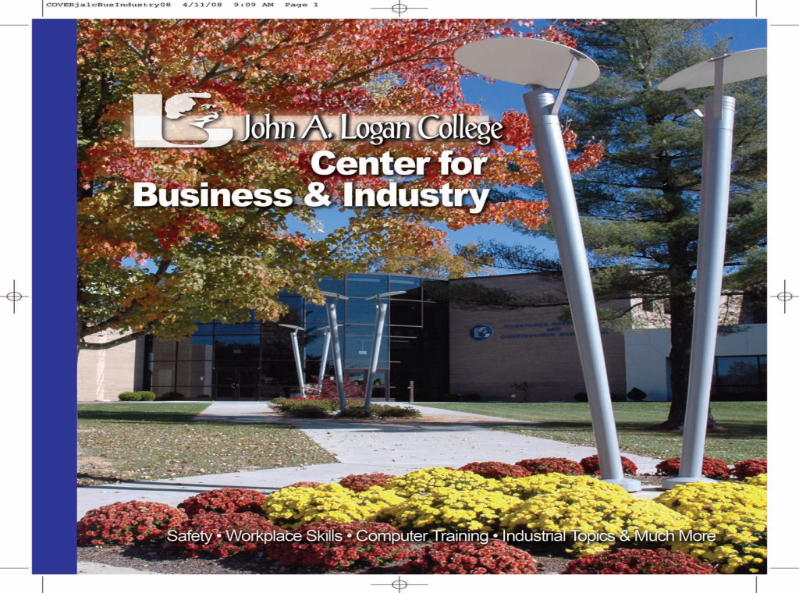

Slide 10
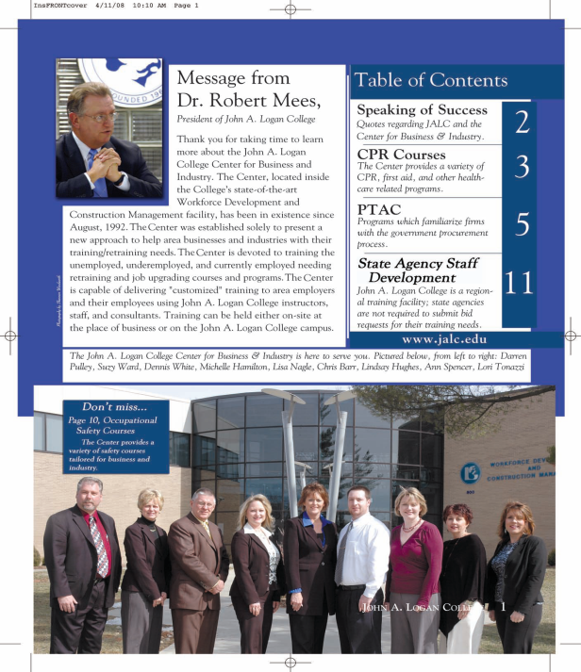

Slide 12
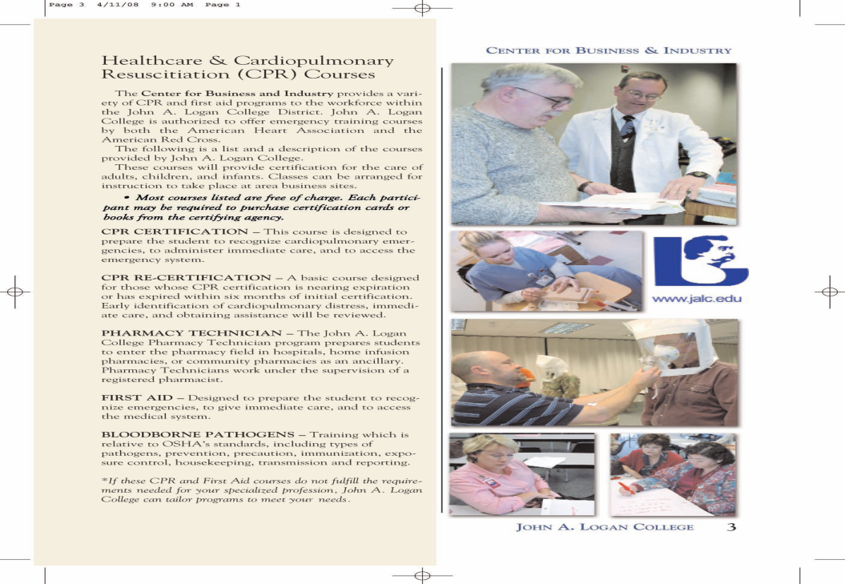

Slide 15
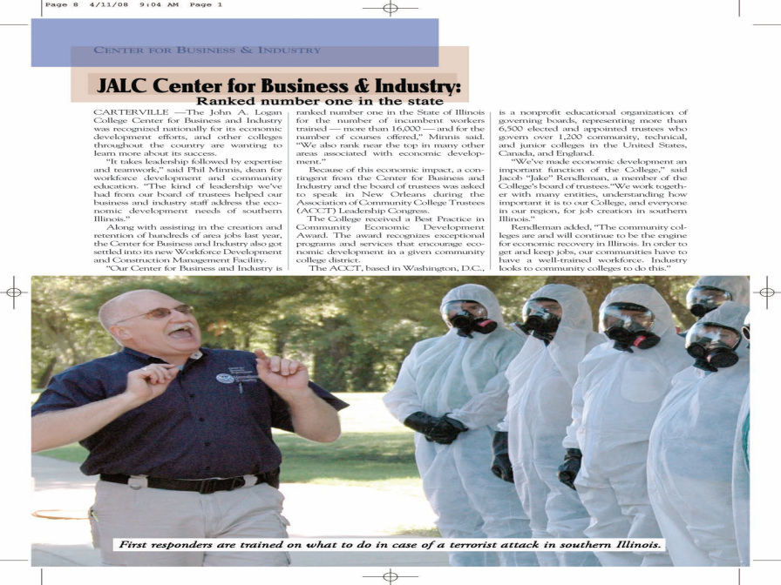

Slide 17
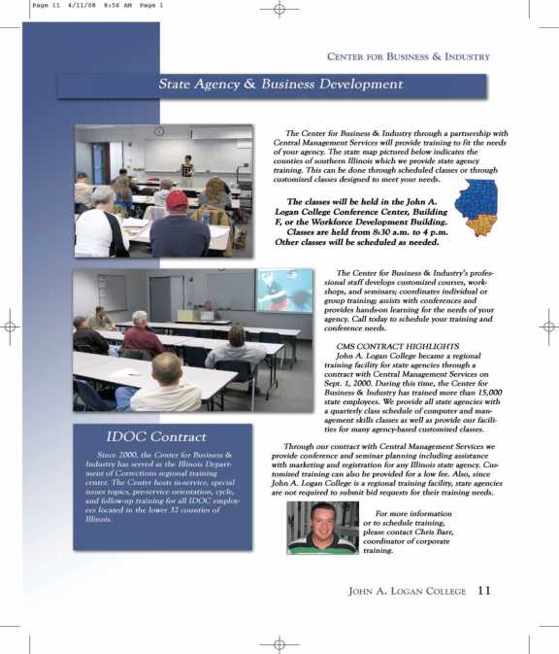

Slide 19
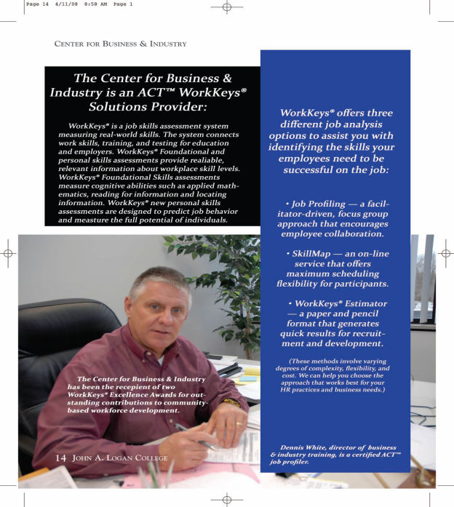

Slide 22
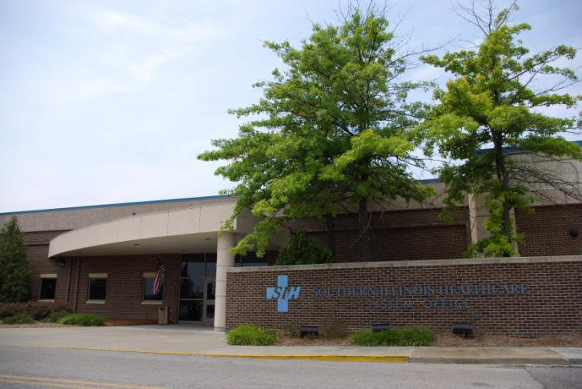
Southern Illinois Healthcare

Slide 23
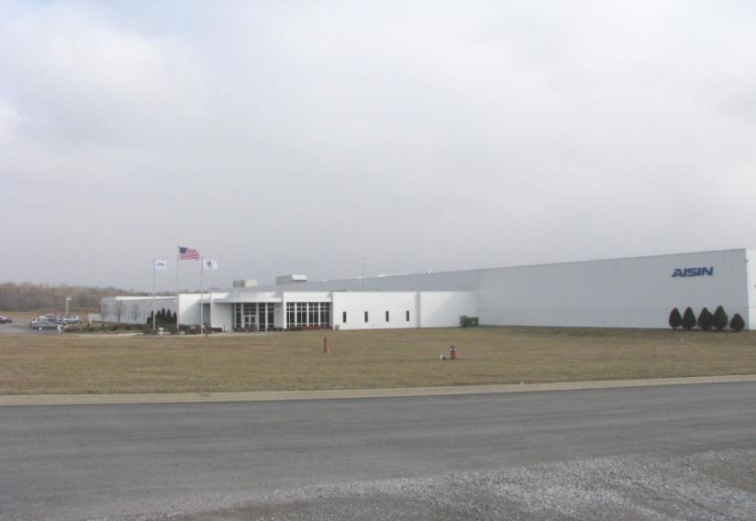
AISIN

Slide 24
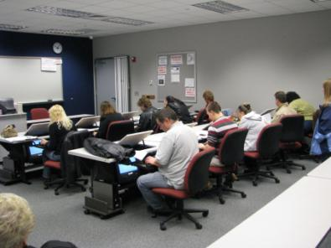
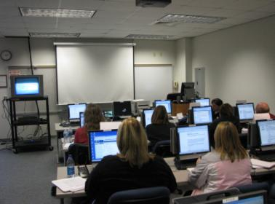
N.E.W. Corporation

Slide 25
Other Initiatives/Challenges
METH
Homeland Security (NIMS)
Cyber Crime
Transitioning Workers
Good-career changes, upward mobility
Bad-layoffs and plant closures
Entrepreneurship Education
Online education
Global competition
Technology
Work ethic

