Slide 1
Using P20 Data to Improve Student Achievement:
A Conversation with the Illinois Board of Higher Education
On the Web: DataQualityCampaign.org
On Twitter: @EdDataCampaign
April 10, 2012

Slide 2
Changing the Culture Around Data Use
Past
Future
Notes:
PAST: compliance focus; flows one way; little value; no one used; no information; box checking; folks didn’t trust it; HAMMER to hurt with
FUTURE: (and some present): data for continuous improvement/to inform conversations: flows to all stakeholders in tailored ways, in timely manner: meets people’s needs.
With longitudinal data systems and a culture that value and uses them:
Richer, more actionable information is not available that can be used to provide TRANSPARENCY, more meaningful accountability measures, inform decision making.
Specifically:
TRACK TRENDS ACROSS SYSTEMS OVER TIME
HIGHLIGHT PROGRESS of sub populations and identify if those groups are making adequate academic growth each year (and why or why not)
Follow individual student’s progress over time and make timely, proven interventions to assist/support that student and tailor teaching/programs to specific needs.
Figure out what is working, what our return on investments are bearing, how well programs/curricula are impacting achievement
Ensure alignment of our efforts: when systems can talk with each other, can provide feedback on how well prepared students were for each transition

Slide 3
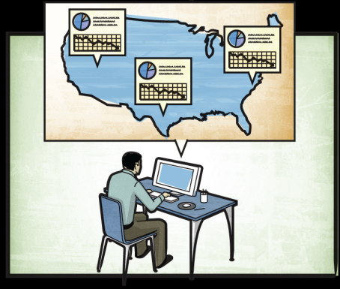
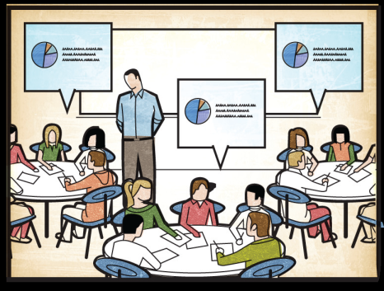
In search of alternatives to dartboards!
In the education sector, leaders…
Make decisions by hunch or anecdote
Throw darts hoping to hit the bullseye
In all other sectors, leaders…
Make decisions based on data
Have dashboards at their fingertips
To get from “here” to “there”, leaders…
Must lead a culture change
Support data use for continuous improvement
Notes:
QUESTION: how many of you bought car this year? Bought or sold a house? Went on a date?
How many of you made any of those decisions without checking out the pertinent data?
WE DON’T USE DATA THE SAME WAY IN EDUCATION AS WE DO IN ALMOST EVERY OTHER PART of our lives or in other sectors!
This is not an IT issue…this conversation is a policy issue and until policymakers make it a priority, data will never fully be leveraged/maximized to improve student achievement
Not data for data sake; this is data for the purpose of improving system performance and student achievement and your role is critical
Glad you are joining us and eager for a thoughtful, vibrant conversation the next 24 hours!
Theme is LEADERSHIP– as we will see in videos we will be showing over the next 24 hours—leadership matters; need champions at state level to change this culture to value information.

Slide 4
Data Defined: Moving Beyond Test Scores
The most useful data are:
Longitudinal — follow individual students over time.
Actionable — timely, user friendly and meaningful to users.
Contextual — robust, comparable and presented as part of a bigger picture.
Interoperable — matched, linked and shared across systems and sectors.

Slide 5
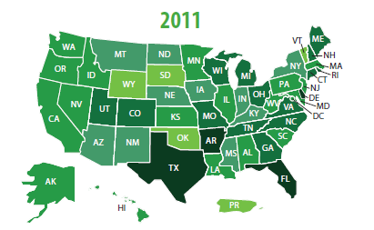
2011 National Landscape
No state has all 10 Actions
10 State Actions
Link P-20/W Data Systems (11 states)
Create stable, sustained support (27)
Develop governance structures (36)
Build data repositories (44)
Provide timely data access (2)
Create individual student progress reports (29)
Create longitudinal reports (36)
Develop research agenda (31)
Build educator capacity (3)
Raise awareness of available data (23)

Slide 6
Establishing the RIGHT Structure with the RIGHT People
Agency 1
Agency 2
Agency 3
Executive Board
Data Governing Board
Data Steward Group
Source: NCES

Slide 7
Bridging P-20/W Silos to Ensure Effective Data Use
Please insert the bridge document here

Slide 8
P20 Governance: A Composite Solution to the Thorniest Issues
Turf
Trust
Technical Issues
Time
Notes:
These are the big challenges in bridging the silos and why policy leadership is critical in P20 governance; without policy leaders these challenges can’t be overcome or will be a drain on the available resources
Turf: Provides a forum to build relationships and conduct open conversations; creates a culture of shared responsibility; provides a forum for agencies to work collaboratively with clear and distinct roles and responsibilities (when everyone is in charge, no one is in charge), toward commonly established goals
Trust: Set the standards for data quality and use so all agencies and stakeholders trust the information; ameliorates fears to how other sectors might use the data because common understanding among agencies established through governance; reassures all that data is used for intended purposes
Technical issues: Stewards the work of link, match, share. Point solutions (NSC)? Integrated solutions?
Time: Establishes the authority for agencies to jointly act and requires sectors to prioritize and agree upon how time is spent; gives agencies the right to spend staff time governing data

Slide 9
Minnesota
Governing Body
P-20 Council
MDE
K-12 Representation
OHE
Higher Education Systems
DEED
Business
Citizens
SLEDS
Inter-Agency
Governance Structure Relationships
Research Committee:
U of M
MNSCU
Private Colleges
P-12
OHE
MDE
Data Advisory Committee:
U of M
MNSCU
Private Colleges
P-12
OHE
MDE
OET
System Coordinators
MDE -OHE
IT STAFF
MDE -OHE
State
Data Center
OET
Minnesota Department of Education:
Commissioner
Research staff
Minnesota
Office of
Higher Education:
Director
Research staff
Minnesota Office of Enterprise Technology
Tech Support

Slide 10
Establishing Data Governance: State Examples
New Mexico
NM, Legislation, Bill H.B. 70a
Minnesota
MN, Minnesota P-20 Statewide Longitudinal Education Data System Charter
Minnesota P20 Education Partnership Bylaws and Resolution
Linking and Sharing Data: Governance Structures for Longitudinal Data Systems, Alice Seagren (MN)
Maryland
MD SB 275 Establishing Longitudinal Data System and Data Governance Board
Washington
Education Research and Data Center

Slide 11
A Sample of Maryland’s Policy Questions
Policy Question | Can the question be answered with the LDS as it is currently configured |  | Comments
 | Yes | No
Are students academically prepared to enter college and complete their programs in a timely manner? | X |  | The question can be answered if an academically prepared student is defined as one who meets the University System of Maryland’s admissions standards, and if high school-level transcript data are available in the LDS.
What percentage of Maryland high school graduates entering college are required to take developmental courses and in what content areas? | X
How does performance in developmental course work (i.e., persistence and transfer/graduation) vary among students of different backgrounds? |  | X | No. This information is only available for recent high school graduates.
Which students are being lost in the transition between community colleges and 4-year institutions? | ? | ? | The term “lost in transition” needs to be clearly defined.
Are graduates of Maryland colleges successful in the workforce? | ? | ? | Further clarification is needed including defining the term “workforce success”.

Slide 12
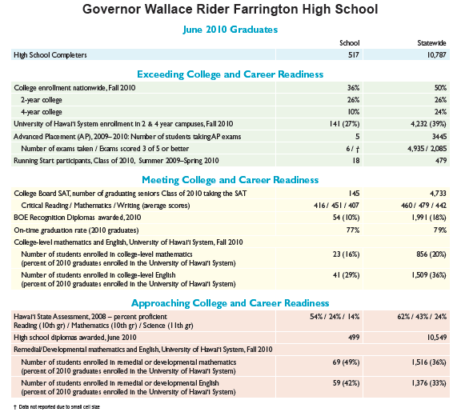
Is the Data Actionable? Hawaii’s High School Feedback Report

Slide 13
Is there broad acceptance and understanding of the role of SLDS by key stakeholders?
Is there an understanding of the goals for collecting, sharing and use of these data?
Are there data champions? Who are they?
Who are the potential detractors? How do you turn them into allies?
Commitment
Policy & Programmatic Questions
Has the state developed agreed upon policy and programmatic questions to be addressed by data? What are they?
How are these policy and programmatic questions related to state (or agency) goals and objectives?
Does the state have realistic timelines and budget for completing relevant analysis?
Does your state have a governance structure in place to have discussions about sharing data across districts, sectors and/or states?
Is there cross-sector representation? If yes, from which agency /entity?
Is there a governance plan in place for determining which data are accessible and to whom they are accessible? Are data available to researchers?
Does the plan include what data should be collected, shared, and linked?
Governance
Does your state have the necessary agreements among various sectors to ensure data can be shared across and among the P20/W spectrum and with other critical agencies?
How does your state link cross-sector data? A repository?
Is the development of a P16/P20 LDS mandated in state policy?
Has the state educational LDS received funding in the states budget?
Sharing & Linking Data
Data Access & Use
Has the state developed portals to make it easier for stakeholders to access data? Has it engaged stakeholders to ensure that they are providing timely access to the data?
Has the state produced reports using student-level longitudinal data to help guide instructional and programmatic improvements?
Has the state produced reports using aggregate longitudinal statistics to help guide system improvements?
Building Stakeholder Capacity
Has the state developed a research agenda that leverages its linked P20/W data systems?
Has the state developed a plan to provide training and PD to policymakers, practitioners / educators, and staff who will need to use and access these data? Who is responsible for the development and implementation of this plan?
Has the state reached out to the public to inform them of available data?

Slide 14
DRAFT Recommendations for States
Ensure your state’s P20W governance body has the RIGHT structure with the RIGHT people
Ensure the P20W governing body has the AUTHORITY to make the necessary decisions and that the roles and responsibilities are clearly defined and complement, not compete, with other governing bodies
Determine if your current P20W governance structure is SUSTAINABLE to ensure continuity of the state’s vision for the data system to meet stakeholder needs
Ensure that the P20W governing body is meeting their responsibilities and being held ACCOUNTABLE

