Slide 1
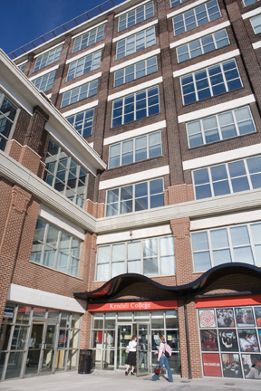
Kendall College
Kendall College cultivates students’ passions into rewarding professions through rigorous learning experiences in the classroom, local communities, and the world

Slide 2
Kendall College: Preparing Successful Graduates for 75 Years
Founded in 1934
Moved from Evanston in 2005
2300 students
Kendall College is a premier provider of quality education focused on services industries
SCHOOL OF BUSINESS
SCHOOL OF CULINARY ARTS
SCHOOL OF EDUCATION
SCHOOL OF HOSPITALITY MANAGEMENT
Accredited by The Higher Learning Commission of the North Central Association of Colleges and Schools*
* www. ncahlc.org, 800.621.7440

Slide 3
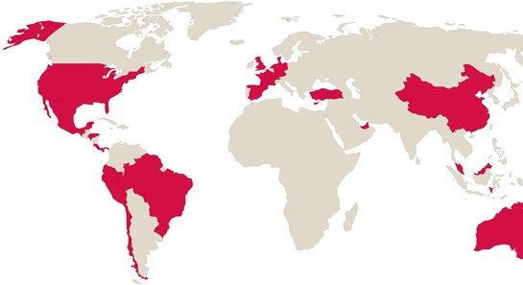
A uniquely Chicago school within a global learning network
Kendall College
A member of Laureate International Universities
…a global network of 59 institutions of higher learning
…with 100 campuses in 25 countries
…offering over 130 career-focused undergraduate, master’s and doctoral degree programs
…internships and professional opportunities in Europe, Latin America, Australia, and Asia

Slide 4
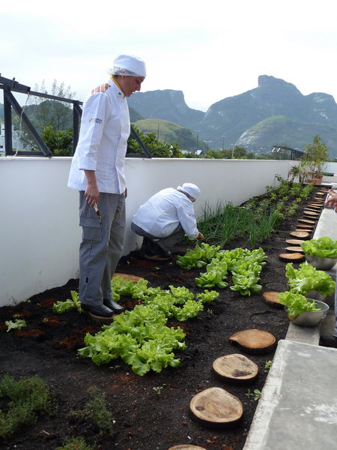
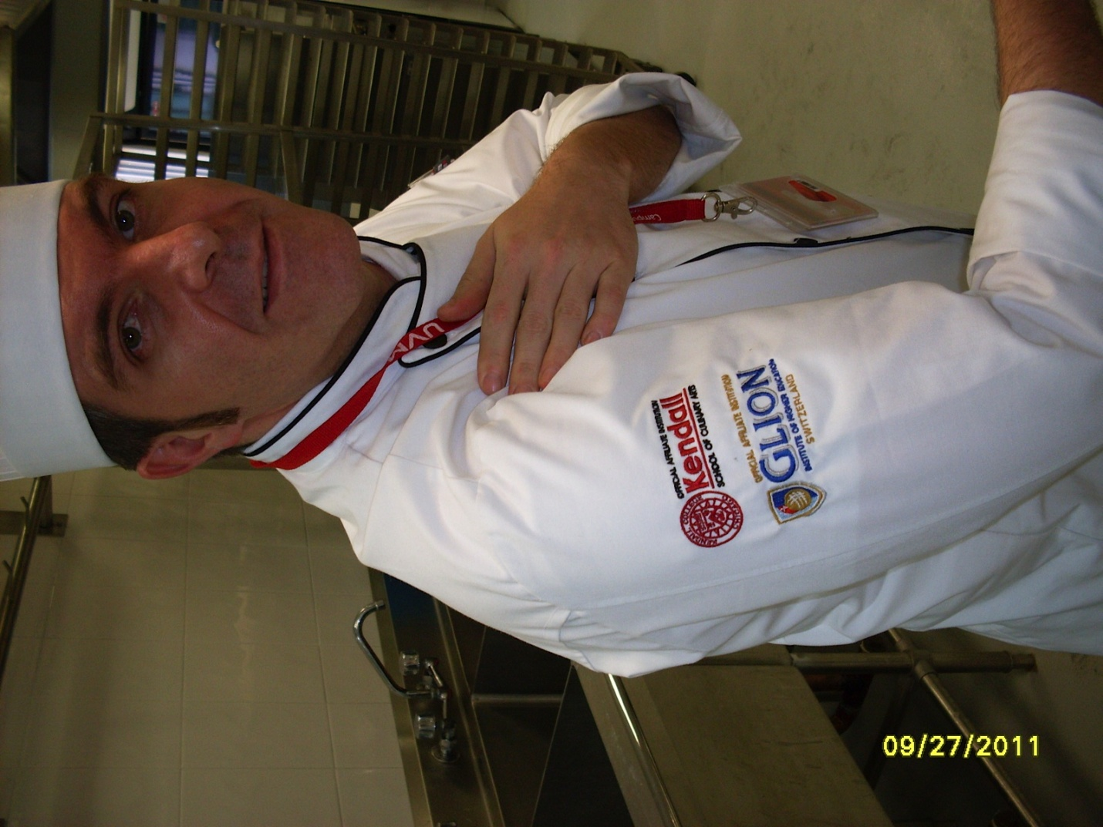
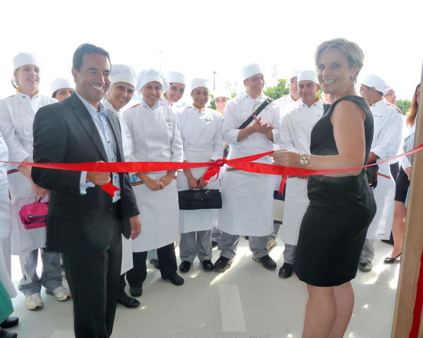
Kendall launches non-credit certificate programs in Ecuador, Mexico, Chile and Brazil
Brought expertise and passion for sustainability to Brazil and Mexico
Grand opening of IBMR culinary school in Brazil

Slide 5
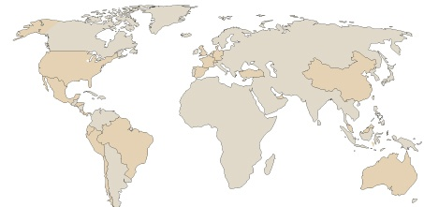
Our Students
74% Female and 26% Male
65% Adult and 35% Traditional
Diverse student body: 21% Black, 13% Hispanic, and
8% International
54% Campus-based, 7% Hybrid, 39% Online
42 states, 58 countries represented

Slide 6
Kendall Bridge Program
Program designed to provide prospective students with
potential, an opportunity to prove ability to succeed
Support development of their academic skills and learn other skills such as time management, study skills, and basic technology
Non-credit program offered to prospective students prior to admission
8 week program - $150, taught by Kendall faculty
Success Rates: More than 80% of bridge students have subsequently matriculated into one of Kendall’s academic program. Once enrolled, those students had an 82% retention rate to their second quarter (n=39 students) and a 75% retention rate to their third quarter (n=28 students).

Slide 7
Committed to the Professional Development of our Students
Real-world curriculum taught by credentialed and experienced practitioners and industry leaders
Collaboration and cross-disciplinary learning within three program areas, culminating in an Integrative Senior Capstone Project
Programs designed to create graduates who are:
PROFESSIONAL
EMPLOYMENT-READY
RESPONSIBLE
POLISHED
CREATIVE-THINKERS
GLOBALLY ATTUNED

Slide 8
Graduate Employment Rates
92% of our 2010–2011 graduates who were seeking employment in their field found jobs within six months of graduation*
96% of Hospitality Management B. A.
96% of Baking & Pastry A.A.S.
98% of Culinary Arts A.A.S.
100% of Culinary Arts B.A.
84% of Early Childhood Education B.A.
75% Business B.A.
86% Culinary Certificate

Slide 9
A Thought Leader in Sustainability
Environmental stewardship is cornerstone of our mission to prepare and inspire students to become industry leaders and responsible global citizens
An integral part of our curriculum and our operational practices
Inclusive of everything from composting, recycling and energy-conservation programs to sourcing locally grown, organic ingredients
Having a sustainable garden that grows produce for its restaurants and teaches students the basics of sustainable agriculture operated by Kendall
In partnership with Fresh Moves to tackle Chicago food deserts

Slide 10
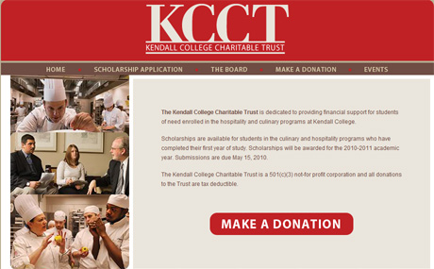
Kendall College Charitable Trust
The Kendall College Charitable Trust, a 501(c)(3) not-for profit, is dedicated to providing financial support for students of need enrolled in programs at Kendall College.

Slide 11
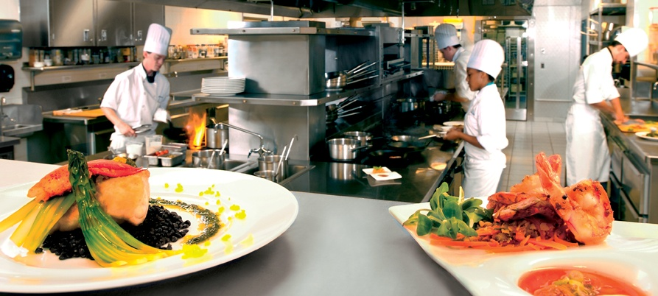

Slide 14
Kendall College
Ranked by employers as the #1 school for culinary and hospitality education in Chicago
(ORC, 2011)

