Slide 1
A Longitudinal Study of Illinois High School Graduates with Disabilities: A Six-Year Analysis of Postsecondary Enrollment and Completion
Illinois Board of Higher Education
Eric J. Lichtenberger
Illinois Education Research Council
Southern Illinois University Edwardsville
Tom L. Thompson
William R. Harper College
February 7, 2012

Slide 2
Context of the Current Study
Nearly all degree granting postsecondary institutions enroll students with disabilities (Raue, 2011)
700,000 students with disabilities enrolled in postsecondary during AY 2008, half at community colleges.
Largest categories were specific learning disabilities and ADD/ADHD.
Growing enrollments of students with disabilities in postsecondary education (Newman et al, 2010)
The rate of enrollment doubled from 1990 to 2005 from one-quarter to one-half.
Students with disabilities less likely to enroll overall, but were more likely to enroll at a community college or in a vocational program than same-age peers.
Less likely to graduate or complete a program overall, but more likely to complete a community college degree.
Notes:
88% of all degree granting institutions and 99% of medium and large institutions
The rate of enrollment within 4 years of graduation nearly double from 1990 to 2005 from 26% to 46%.

Slide 3
The Current Study
Who is included in the cohort
113,135 public high school students who took the Prairie State Achievement Exam (PSAE)/ACT in the Spring of 2001 and indicated that they will be graduating in 2002.
Who is not included in this cohort
Private high school graduates
Out-of-State high school graduates that migrated to Illinois higher education institutions

Slide 4
Research Questions
To what extent do students with disabilities differ from students without disabilities regarding key demographic factors?
What are the differences between students with disabilities and students without disabilities in terms of their postsecondary enrollment and degree completion patterns?

Slide 5
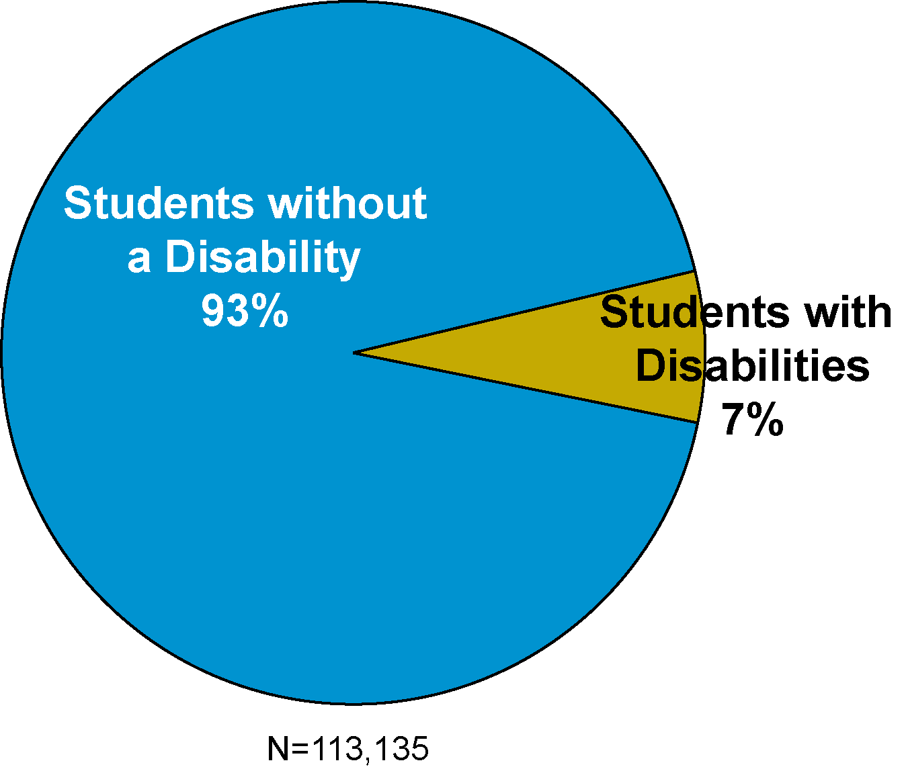
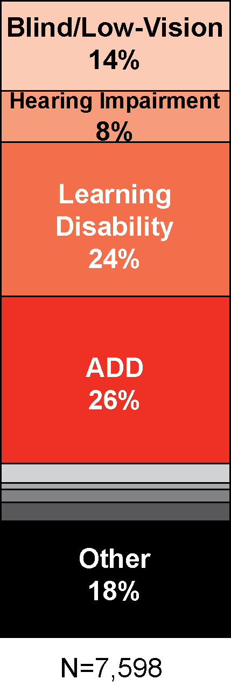
How Disability was Defined
in the Current Study
8. Please respond to this item only if you have a physical or diagnosed learning disability. Mark the one choice that most closely describes your situation.
Blind or low-vision (not correctable
with prescription lenses) ............. 1
Hearing impairment .................... 2
Learning disability ....................... 3
Attention deficit disorder ............ 4
Other neurological impairment … 5
Require wheelchair access ........ 6
Other orthopedic impairment ..... 7
Multiple disabilities ..................... 8
Other disability............................. 9
Source: ACT Assessment: Student Information 2001-2002

Slide 6
Students with disabilities had overall characteristics that would suggest a lower likelihood of postsecondary enrollment and degree completion.
They were significantly less likely to be college ready

Slide 7
Students with disabilities had overall characteristics that would suggest a lower likelihood of postsecondary enrollment and degree completion.
They were significantly more likely to be male

Slide 8
Students with disabilities had overall characteristics that would suggest a lower likelihood of postsecondary enrollment and degree completion.
They were more likely to be within the low income category

Slide 9
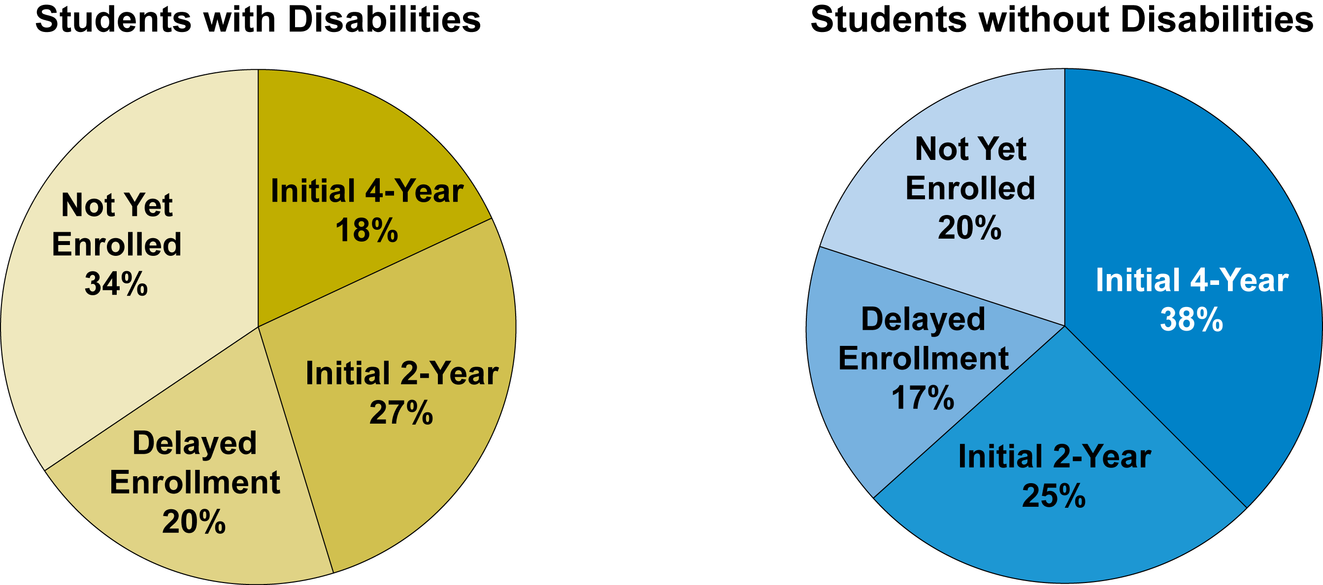
A high proportion of students with disabilities are enrolling in college (66%) Students with disabilities were:
Significantly more likely to have not yet enrolled
Slightly more likely to delay postsecondary enrollment
Significantly less likely to enroll at a four-year college
Slightly more likely to utilize the community college system
34% to 20%
18% to 38%
20% to 17%
27% to 25%

Slide 10
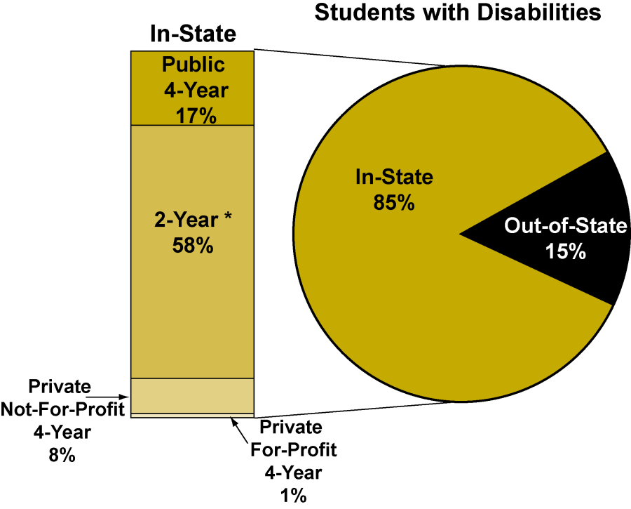
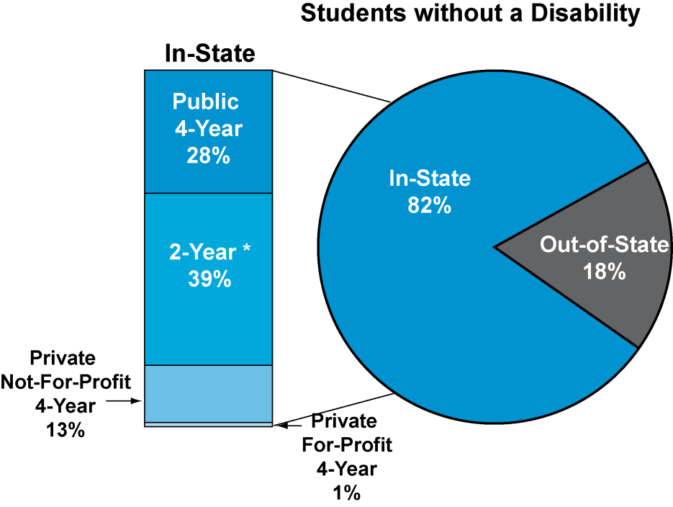
Sector-Among those initially enrolling after high school graduation, students with disabilities were:
Slightly more likely to stay in-state
85% to 82%

Slide 11
Sector-Among those initially enrolling after high school graduation, students with disabilities were:
More likely to utilize in-state public 2-yr and 4-yr schools rather than private institutions

Slide 12
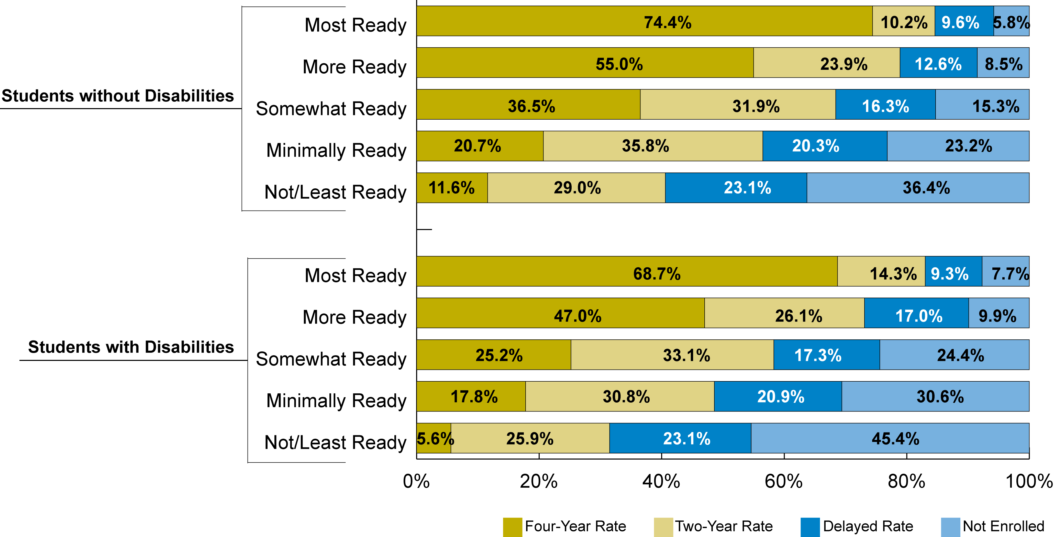
Differences in overall enrollment were fairly minimal at the top of the college readiness index
Difference of 1.9 percentage points
Difference of 1.4 percentage points
Notes:
Mean ACT scores are fairly similar at the top end of the college readiness index across the disability status groups. However there were difference in terms of the selectivity of the four-year institutions in which the students enrolled, as students with disabilities had slightly higher probabilities of enrolling at the most selective institutions.

Slide 13
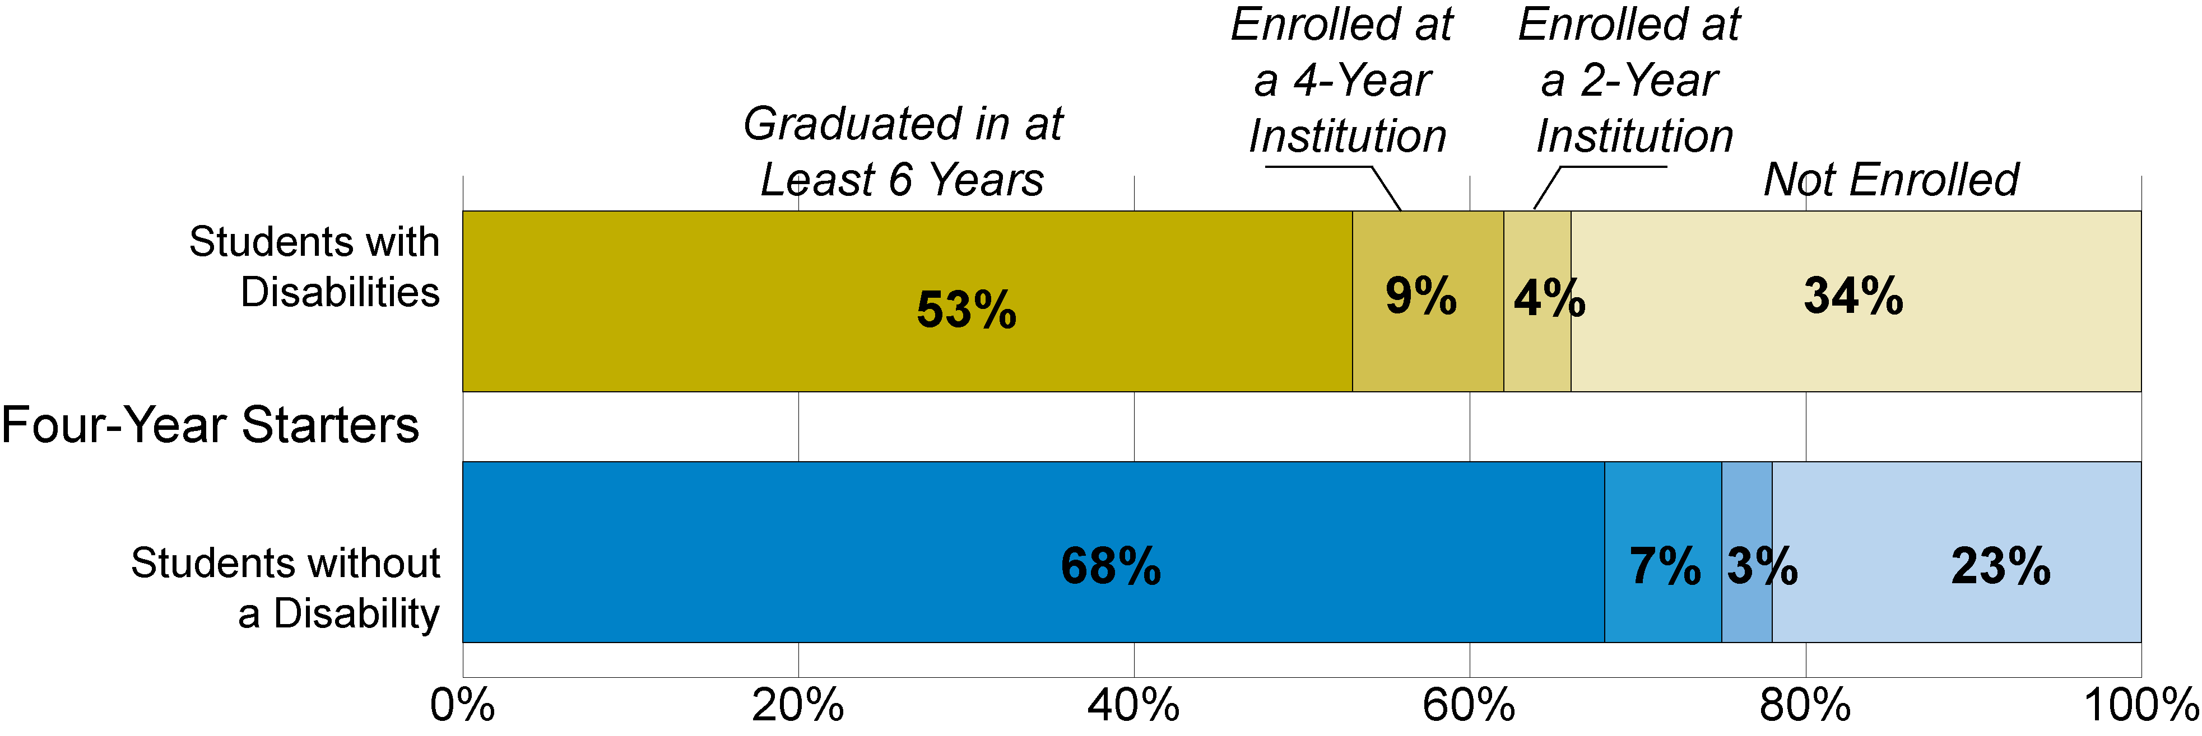
There were large differences between the two groups in terms of end of study status.
Students with disabilities were at a much higher risk of dropping out of college
34% to 23%

Slide 14
There were large differences between the two groups in terms of end of study status.
A higher proportion of students with disabilities were still enrolled at the end of the study
13% to 10%

Slide 15
There were large differences between the two groups in terms of end of study status.
Students with disabilities were significantly less likely to complete a bachelor’s degree in six years
53% to 68%

Slide 16
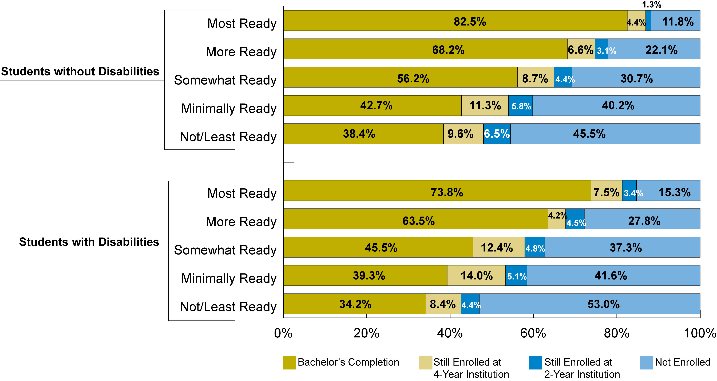
Disability Status, College Readiness, and Bachelor’s Completion
The more and most ready students with disabilities lagged behind their same age peers in terms of bachelor’s completion.
Notes:
Mean ACT scores are fairly similar at the top end of the college readiness index across the disability status groups. However there were difference in terms of the selectivity of the four-year institutions in which the students enrolled, as students with disabilities had slightly higher probabilities of enrolling at the most selective institutions.

Slide 17
There were significant differences between the various disability subgroups in terms of the postsecondary outcomes.
Students with multiple disabilities and those in the other orthopedic category seemed to outperform other disability subgroups.
This was in terms of basic enrollment and degree completion among four-year starters.
In most measures, these students approximated and in some cases had higher completion/outcome attainment rates than students without a disability.
The within group differences might be just as important as the between group differences.

Slide 18
What is Needed?
The Disabilities Advisory Committee wants to see:
Systematic data gathering on students with disabilities for establishing:
Benchmarks about enrollment, provision of accommodations, budget investments
Capacity to track student performance for students with disabilities regarding:
Persistence, retention, time-to-credential, completion

Slide 19
Disabilities Advisory Committee
Major Goal: Disability Metrics
Subgroup on Longitudinal Data System: inclusion of students with disabilities (classification system for types of disabilities). Brad Hedrick – UIUC
Subgroup on Annual Report template: development of new annual reporting in the URG. Inclusive of student demographics, budget/expenditures, provision of accommodations and unique campus features. Tom L. Thompson – Retired, Harper College

Slide 20
Contact Information
Eric Lichtenberger
Associate Director for Research
Illinois Education Research Council
Assistant Research Professor
Southern Illinois University Edwardsville
elichte@siue.edu
IERC
ierc.siue.edu
618-650-3017

