Slide 1
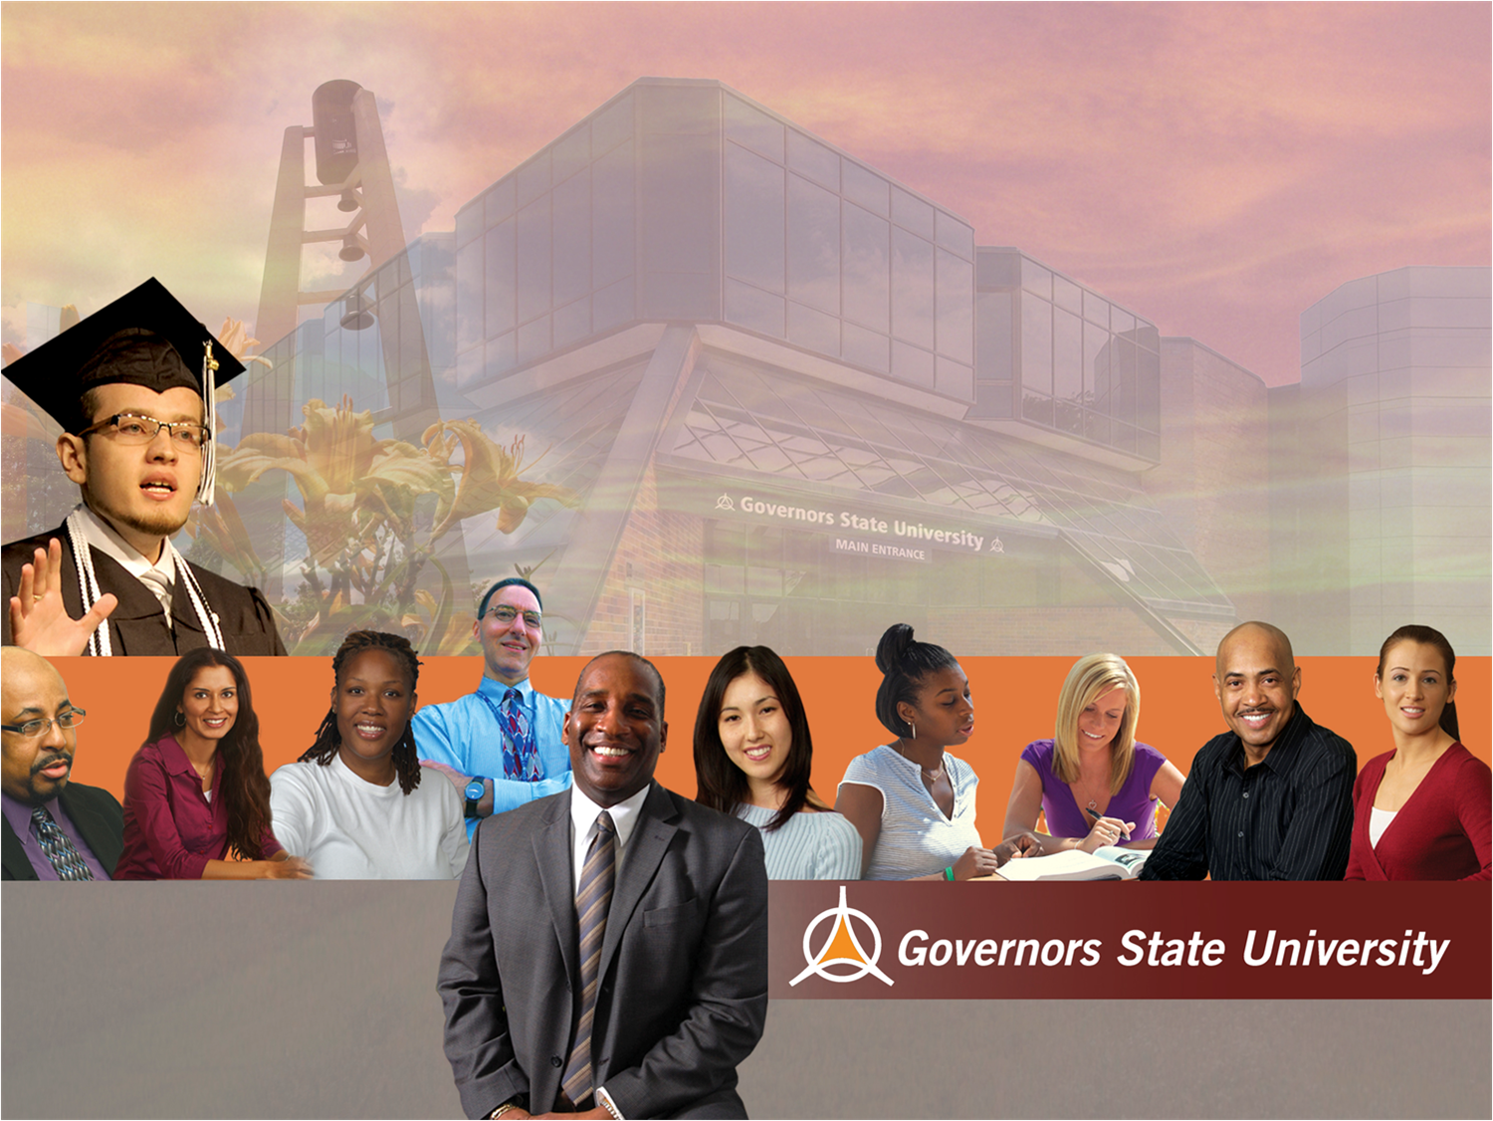

GSU’s Dual Degree Program:
Both/And
not
Either/Or
Illinois Board of Higher Education
April 2, 2013
Dual Degree Program

Slide 2
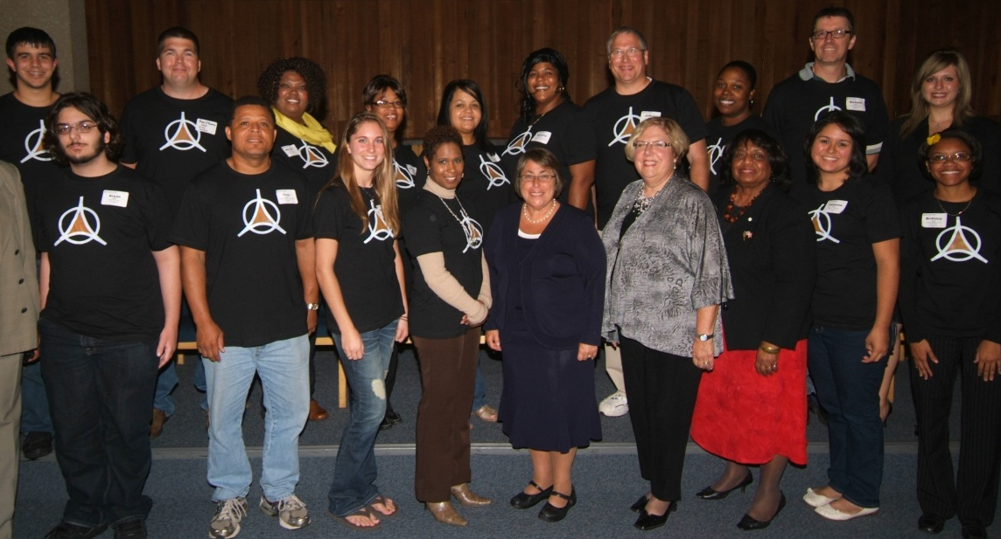
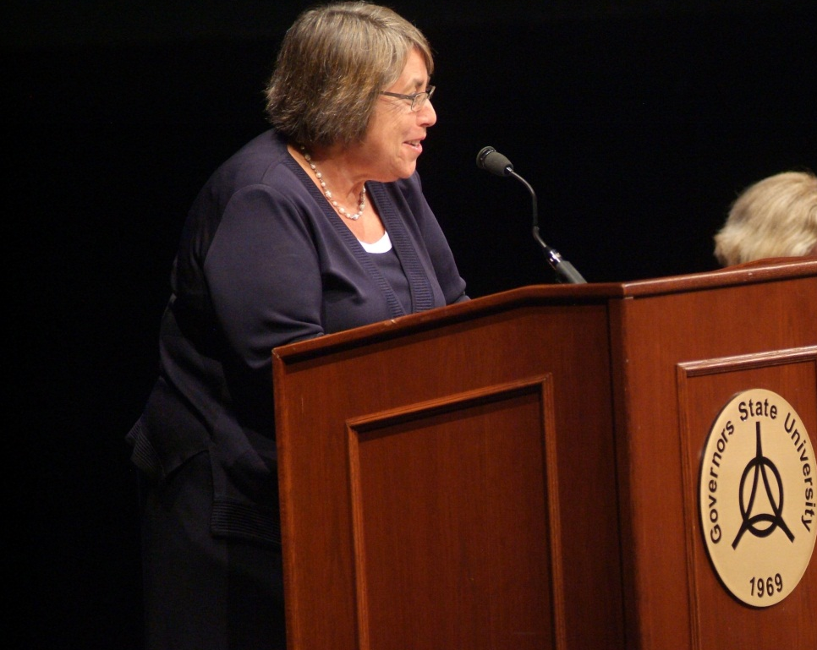
“…island of excellence….”
Dr. Martha Kanter,
Under Secretary of Education

Slide 3

Addressing the goals of the
Illinois Public Agenda
and
Complete College America

Slide 4








Governors State University and
ten community college partners
share a commitment:
Increase the number of students who
complete their associate degrees
and transfer to complete their bachelor’s degrees in high
quality, coherent programs

Slide 5

Research supports each of
the unique components
of the Dual Degree Program

Slide 6
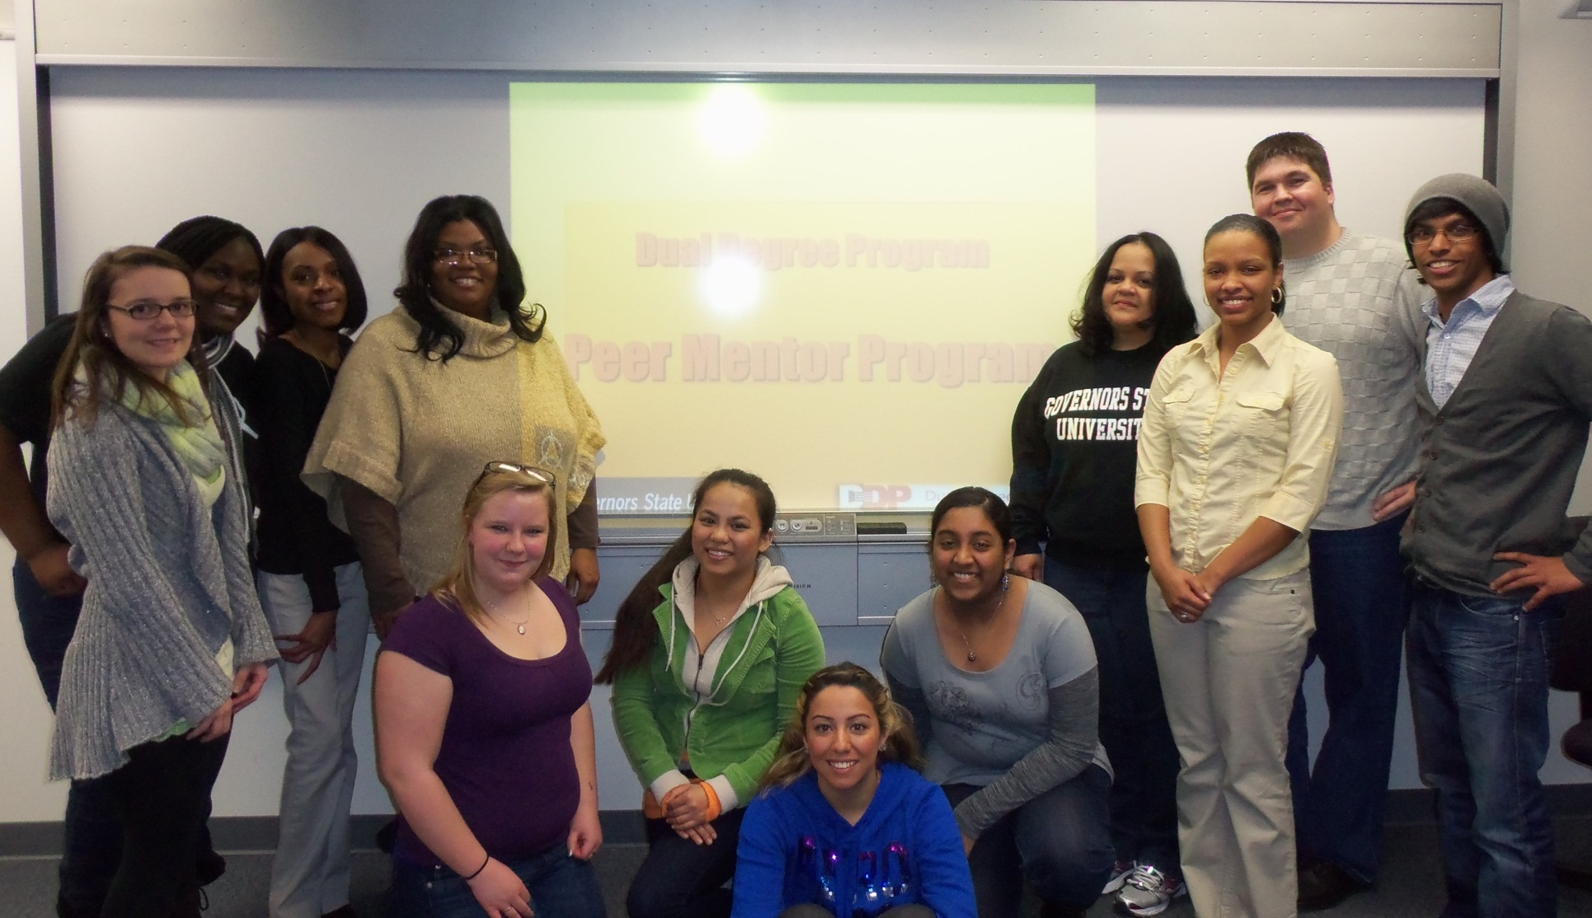
DDP students must attend full-time

Slide 7
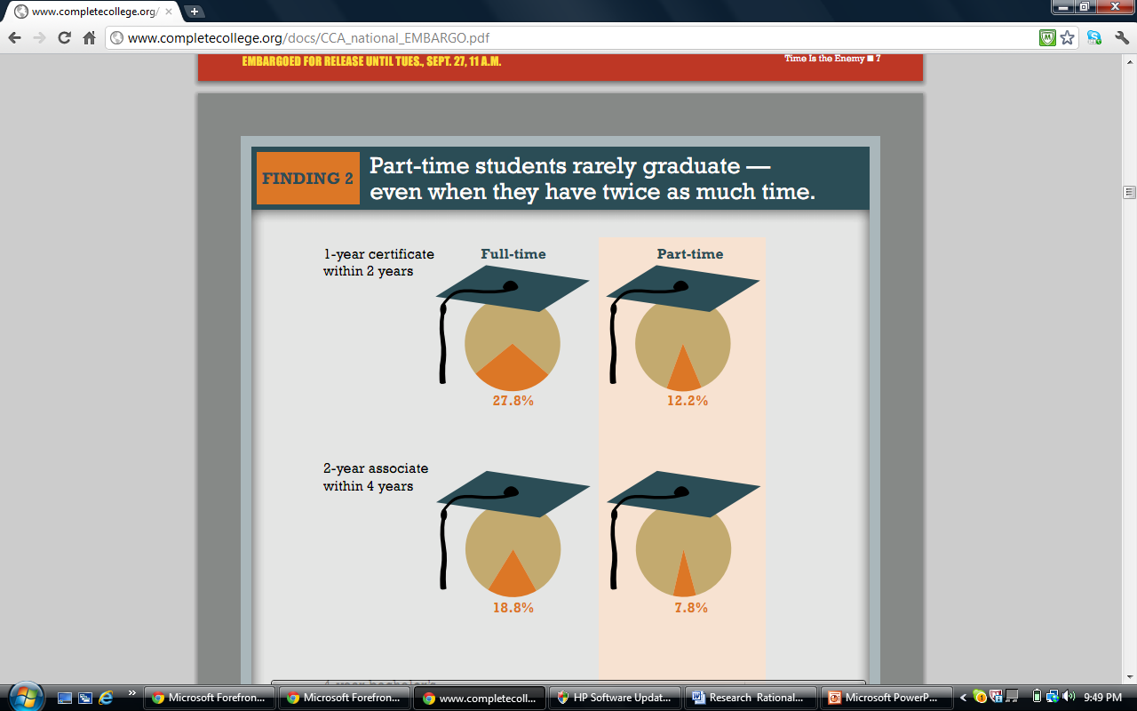
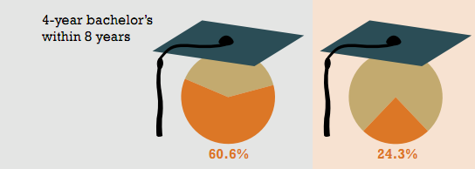
“Time is the Enemy”
Part-time students rarely
graduate --- even when they
have twice as much time.
Complete College America, 2011

Slide 8

DDP students
must complete their
associate degree prior to
transfer to university
Dual Degree Program:
Not dual credit or dual enrollment

Slide 9
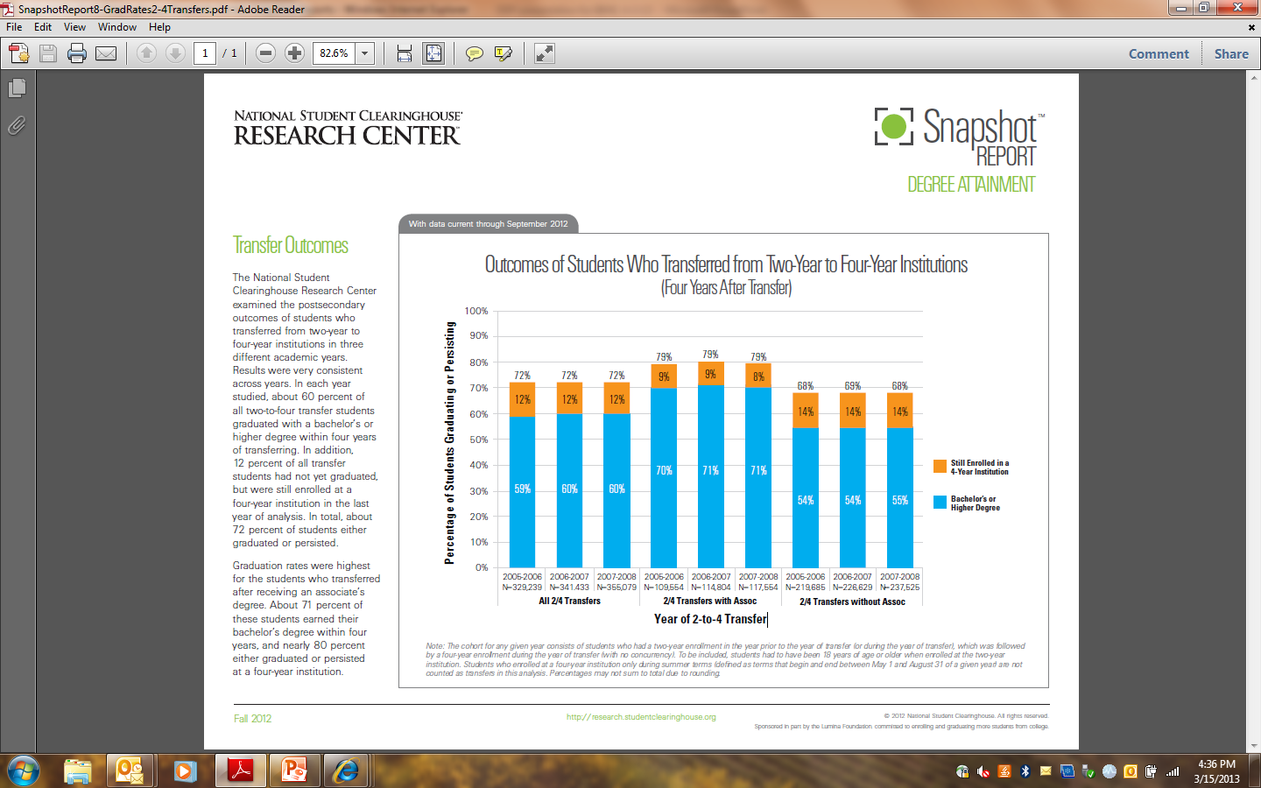

Slide 10

DDP students must participate in structured,
intentional, inter-institutional
advising and mentoring

Slide 11

DDP students receive
academic and financial
incentives and support
  Guaranteed Admission to GSU
  Locked-in Tuition Rate (for four years)
  GSU Promise Scholarships
  DDP Honors Scholarships

Slide 12
$875,000 Grant
Transfer Specialists
Peer Mentors
Certificate of Advanced Study
in Transfer Student Services

Slide 13
So where are we now?
There are 70 students who have earned their
associate degrees and are enrolled in the
first DDP cohort at GSU

Slide 14
There are 340 students currently enrolled
in the DDP and working toward
their associate degrees at our
partner community colleges

Slide 15

25 students were awarded the first
GSU Promise and DDP Honors Scholarships
- Majority are low income (52% are Pell-eligible and
44% have an Expected Family Contribution [EFC] of 0)
- Recipients are very diverse: 44% are African American
and 8% are Hispanic
- 63% of the students were in
Phi Theta Kappa and/or
the Honors Program at their
respective community
colleges

Slide 16
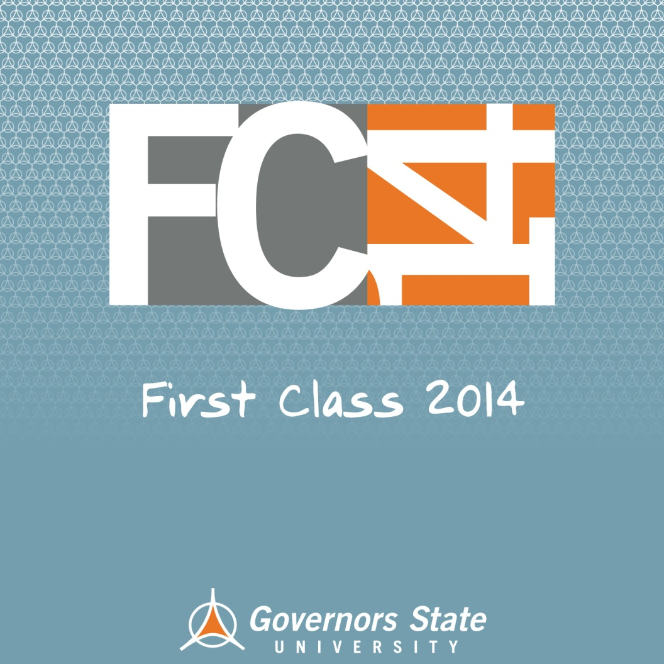
GSU may be the first university
in the nation to recruit students
for a community college pathway
in our own Freshman
Viewbook, cheerfully
competing with
ourselves in the
interest of students

Slide 17
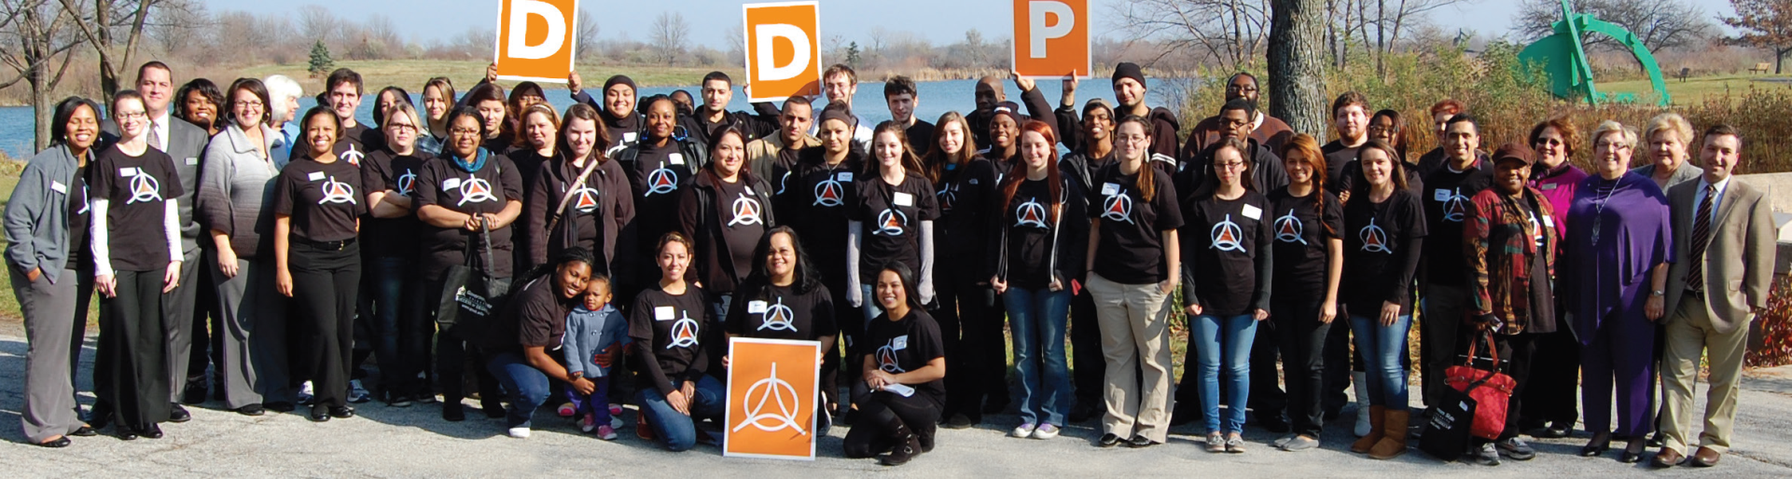

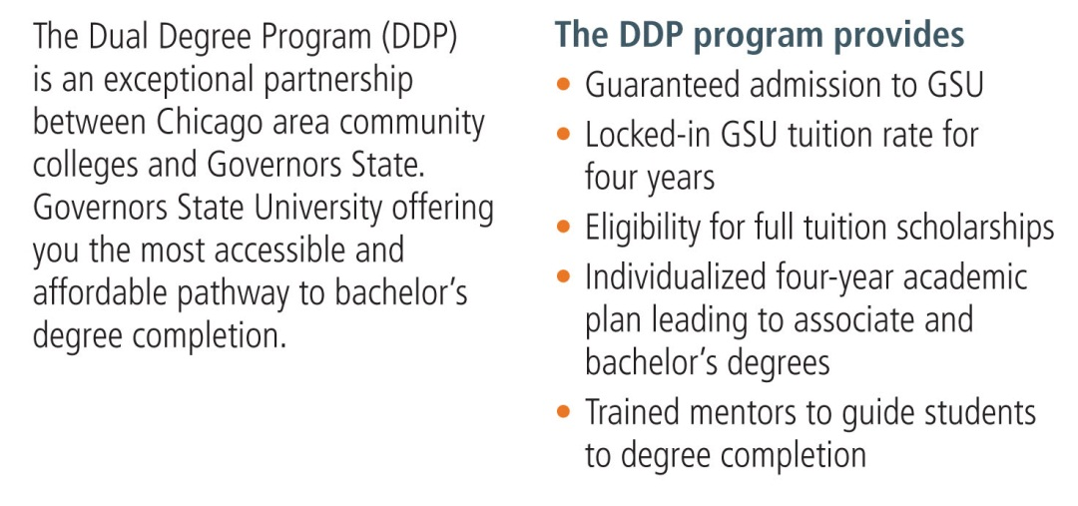













Slide 18
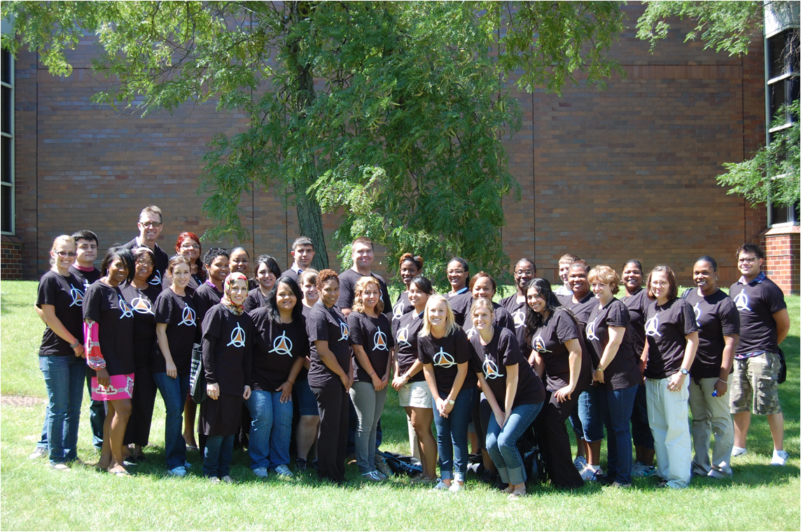
Questions?

