Slide 1
Advancing the Public Agenda Through Early Childhood Initiatives
Illinois Board of Higher Education Meeting
October 1, 2013
Stephanie Bernoteit, Ed.D., NBCT - IBHE Academic Affairs
Theresa Hawley, Ph.D. - Governors Office of
Early Childhood Development

Slide 2
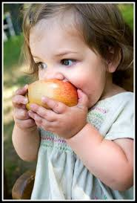
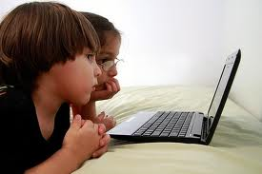
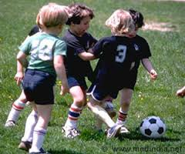
Goal 1: Increase educational attainment
Readiness for college, careers, and citizenship begins in early childhood.

Slide 3
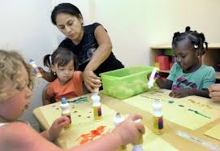
Goal 1: Increase educational attainment
High-quality early childhood programs narrow gaps for disadvantaged children while improving learning and readiness for all.
Barnett (2011); Camilli, Vargas, Ryan, & Barnett (2010); Diamond & Lee (2011)

Slide 4
Goal 1: Increase educational attainment
High-quality early childhood programs have long-term benefits for children and society.
Reduction in grade retention, special education placement, crime, and public dependency
Increased educational attainment, employment, and earnings
Returns on investments ranging from $2.62 to $10 for every dollar spent
Barnett & Masse (2007

Slide 5
Goal 3: Increase the number of high-quality post-secondary credentials
Improving Early Childhood teacher preparation in Illinois:
Recruit the best candidates considering academic achievement, experience, community cultural knowledge, and disposition
Prepare candidates for effective teaching in all EC settings including infant/toddler, English language learners, special education, etc.
Ongoing professional development
Chatman Nelson, Main, Kushto-Hoban (2012)

Slide 6
Our Early Childhood Goal
80% of all children and
will demonstrate “full readiness” at kindergarten entry by 2021
Notes:
We have consensus on this outcome goal, but not full consensus around what we mean by “children with high needs” and “full readiness”

Slide 7
Our Strategic Focus: Ensuring High-Need Children Receive High Quality Early Learning Services
Of children with high needs, by 2016:
65% have at least 1 yr high quality* early learning services
40% have at least 2 yrs
10% have 5 full years
*As defined by Gold Circle of Quality in ExceleRate Illinois
By 2021,
80% of all children will be fully ready for kindergarten

Slide 8
ExceleRate Illinois The new quality rating and improvement system
www.ExceleRateIllinois.com
Notes:
Carol
Welcome everyone to the call
introduce Gail for the governors office of early childhood development

Slide 9
Focus on Continuous Improvement
Common standards across settings
Strong focus on teacher credentials
Notes:
Gail
focus is on Quality Improvement and increasing the quality of programs

Slide 10
Picture of the EC Workforce
Many different sectors and settings (center, school, home)
Motivation for being in field varies
Primarily female
Diversity*:
43.5% - White/Caucasian
35.8% - Black/African American
17.3% - Hispanic/Latino
1.0% - Asian
Most of the field comes into profession in entry level position and gains education as they work their way up in the field
*Data primarily represents licensed center-based workforce

Slide 11
Education and Wages
Educational requirements vary by sector
Teacher
Licensed Child Care Center – 30-60 semester hours with 6 in ECE/CD
Head Start – moving toward Bachelor’s Degree with ECE major
Preschool for All – Bachelor’s Degree with Type 02/04 Certification
Licensed Family Child Care Provider
High School Diploma/GED
Salary also varies by sector
Teacher in Licensed Center with BA in ECE/CD
Avg. $28,912
Teacher in Head Start with BA in ECE/CD
Avg. $32,348
Teacher in school-based PFA with BA and Type 04 Cert
Range ~$25,000-$45,000+
Notes:
All new child care directors hired on or after 7/1/17 must have a minimum of an associate’s degree in ECE or CD

Slide 12
Early Childhood Degree Trends in IL 2007-2011

Slide 13
“Some College”
Gateways Registry – Basic Transcript Review
Reviewed transcripts for 2,248 individuals with “some college” education, but no completed degree
Median = 53 semester hours
44.2% have 60+ semester hours
7.7% have 120+ semester hours
How can we work with this population to help achieve the 60% by 2025 goal AND achieve the quality of early childhood education we need to provide our most vulnerable children?
Source: Gateways to Opportunity Registry September 2013

Slide 14
IBHE Early Childhood Initiatives with ISBE, ICCB, INCCRRA, IDHS, and GOECD
Principal preparation and licensure
Early Childhood teacher preparation and licensure
Early Learning Council’s Higher Education Learning and Professional Development Committee
Grants
Workforce attainment of credentials and degrees
Common Core State Standards

Slide 15
Resources
“Breaking It Down and Building It Out: Enhancing Collective Capacity to Improve Early Childhood Teacher Preparation in Illinois” (Nelson, Main, Kushto-Hoban, University of Illinois at Chicago)
Governor’s Office of Early Childhood Development
http://www2.illinois.gov/gov/OECD/Pages/default.aspx
Gateways to Opportunity
http://www.ilgateways.com/en/
Excelerate Illinois
http://www.excelerateillinois.com/
Illinois Network of Childcare Resource and Referral Agencies
http://www.inccrra.org/
Illinois Early Childhood Asset Map
http://iecam.illinois.edu/

Slide 16
Questions
Theresa Hawley, Ph.D.
Executive Director
Governors Office of Early Childhood Development
Theresa.Hawley@Illinois.gov
Stephanie Bernoteit, Ed.D., NBCT
Associate Director, Academic Affairs
IBHE
bernoteit@ibhe.org

