Slide 1
Illinois Board of Higher Education April 1, 2014

Slide 2
“The Maps They Gave Us Were Out of Date by Years”
The rules break like a thermometer,
Quicksilver spreads across the charted system….
Whatever we do together if pure invention,
The maps they gave us were out of date by years
Adrienne Rich, 1978

Slide 3
A New Map: Illinois' Goal for 2025
To increase the percentage of adults who hold high-quality college credentials to 60 percent.

Slide 4
Total number of undergraduate certificates (one-year and longer), associate’s degrees, and baccalaureate degrees
awarded each year in Illinois compared to the annual number necessary to meet the goal of 60 X 2025.

Slide 5
WHY is Meeting our Goal So Important?
By 2018, nearly 2/3 of all new and replacement jobs in Illinois will require some form of postsecondary education
Currently 46% of Illinois young adults have a two or four year college degree
While we have seen progress it must be accelerated
To address the “skills gap” and meet the talent needs of Illinois we must reduce opportunity gaps for our growing “underserved” population (1st generation, low income, adults and students of color)

Slide 6
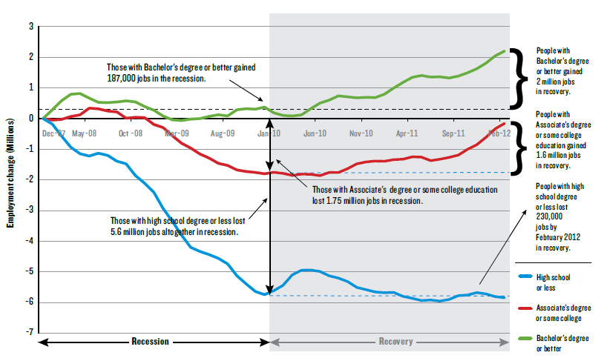
The Finish Line Has Changed: College is Necessary in the New Economy

Slide 7
To Succeed Illinois Needs New Maps For Adult Learners

Slide 8
To Succeed Illinois Needs New Maps Leading to Fairness

Slide 9
To Succeed Illinois Must Abandon Old Maps that Reproduce Privilege

Slide 10
The Path to Progress: Multi-Sector Collaboration for Collective Impact
Having the right partners at the table
Setting a common goal(s)
Creating shared measurement systems
Adopting a shared agenda (priorities)
Implementing mutually reinforcing strategies/tactics
Maintaining continuous communication/trust
Identifying a backbone organization

Slide 11
The Path to Progress: Remodeling Our System
Leadership Commitment
Redesigned Practices
Values-based culture change
Reallocation of resources
Relentless focus on data
Culture of shared accountability
Partnerships with K-12, community, employers
Cohesive core curriculum
Simplified student-pathways
High quality student supports
Intrusive advising
Cohort/project based learning
Innovative use of new technologies

Slide 12
The Path to Progress: Guided Pathways for Student Success (GPS)
Gain broad commitment from Illinois colleges for implementation of guided pathways
Redesign developmental education
Incentivize full time enrollment
Provide structured schedules
Ensure students meet milestones predicting success
Link pathways to workforce and careers
Pay for performance of institutions/students

