Slide 1
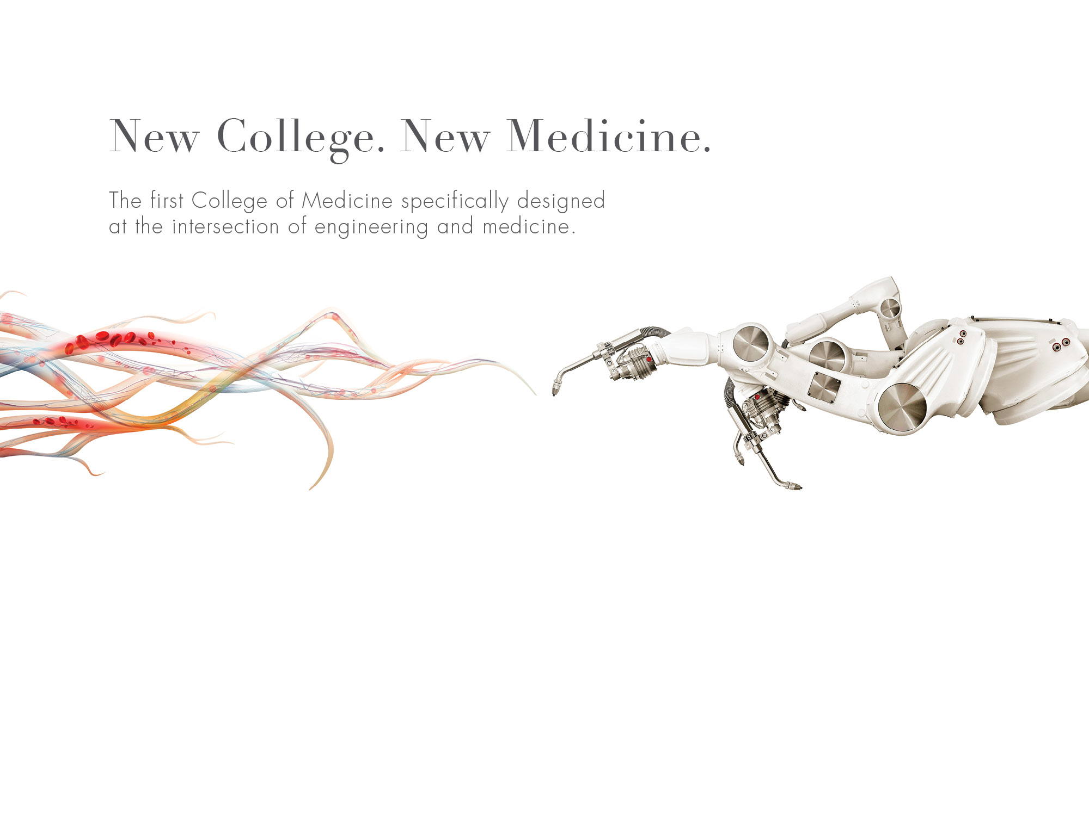

A bold new approach to medical education
Edward Feser
Interim Provost

Slide 2

OUR VISION FOR MEDICAL EDUCATION
We will transform the teaching and practice of medicine to provide better health care to more people at a lower cost.
Notes:
The time is now.

Slide 3
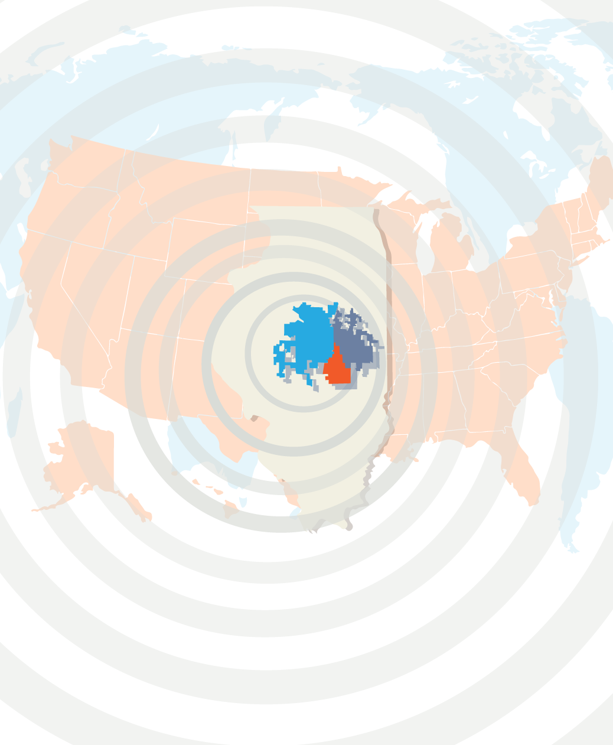
OUR IMPACT
WILL BE
GLOBAL
Locally
Across the state
In the teaching and practice of health care in the U.S.
For human health around the globe
Notes:
The college of medicine will impact not only engineering and medicine, it also will lead to collaborations that will benefit all three University of Illinois campuses, Illinois residents, and health care consumers as a whole.
Global population is expected to reach 9 billion people by 2050.
Healthcare is changing dramatically due to technology advances.
Biology and medicine are the next frontier for engineering.
We must have national and global impact and lower healthcare costs.

Slide 4
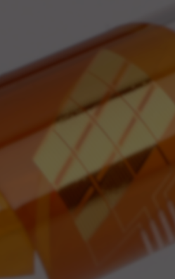
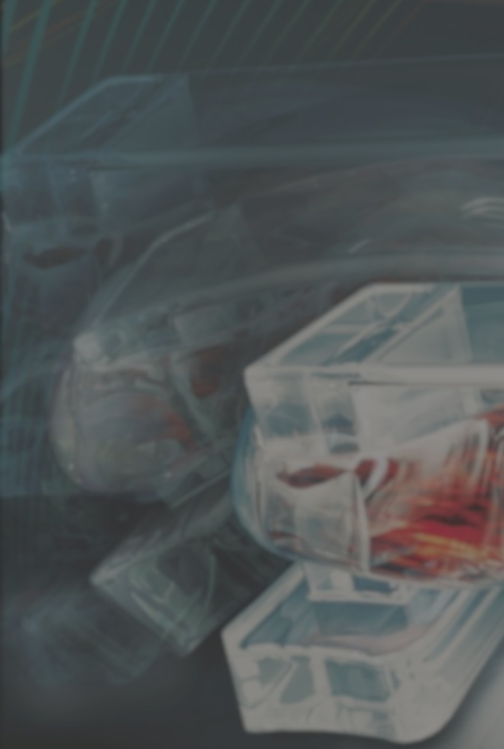
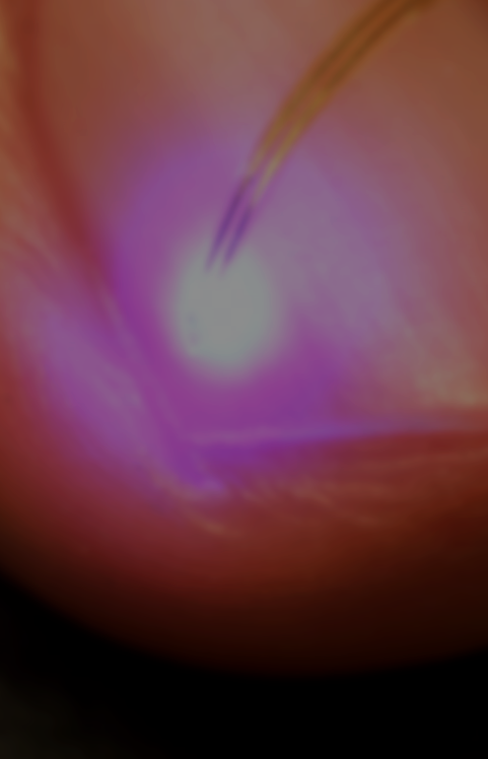
THE STRENGTH OF THE UNIVERSITY OF ILLINOIS AT URBANA-CHAMPAIGN
16 undergraduate or graduate engineering degree programs ranked in the top five, nationally and internationally
Research strength across the entire campus (life sciences, humanities, arts, physical sciences)
Unparalleled assets in engineering, technology and supercomputing
Notes:
Emphasis on faculty resources.

Slide 5

CARLE FOUNDATION HOSPITAL
Nationally recognized
Comprehensive health care system
Serving 1.2M in 35 counties
Level 1 Trauma, Level 3 Perinatal
393-bed critical access hospital
Hundreds of clinical trials
Notes:
Discuss the partnership with Carle, emphasize the structure on the Urbana campus (college will be governed like other UIUC colleges).
Elaborate on the Joint Liaison Committee and the five working groups with representation from both entities. Mention agreements that will govern aspects of the relationship.

Slide 6
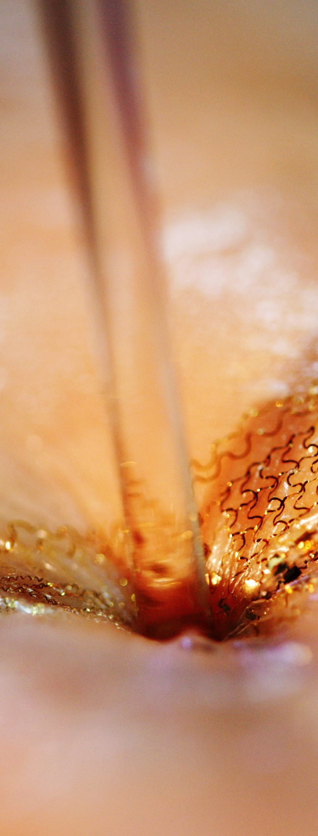
THE CARLE ILLINOIS COLLEGE OF MEDICINE IS DIFFERENT
First curriculum to infuse engineering technologies into health for transformative results
Trained physician-scientists, physician-engineers, medical innovators
First-day immersion in clinical and engineering experiences
Highly selective with 25-50 students per class: nimble, flexible and adaptable educational experiences
Notes:
Engineering-based curriculum
Compliments UI Chicago College of Medicine which provides traditional medical education on a larger scale
Research collaboration with UIC - Paul Hergenrother (UIUC, Prof. Chem) and Tim Fan (UIUC, Assoc. Prof CVM) are collaborating with Arkadiuz Dudek (UIC, Prof. Medicine) to take Paul's small molecule cancer drug, called PAC-1, into human trials. Upon successful filing their FDA Investigational New Drug application in September 2015, a Phase I clinical trial designed by Dr. Dudek was instituted and currently has successfully recruited enough patients for completing the first 3 dose cohorts.
University of Illinois proposal with full support from other campuses, University Administration and the UI Board of Trustees

Slide 7
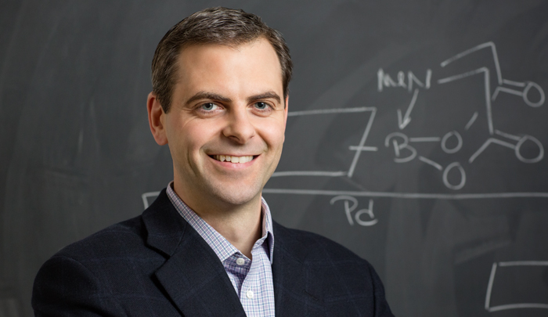
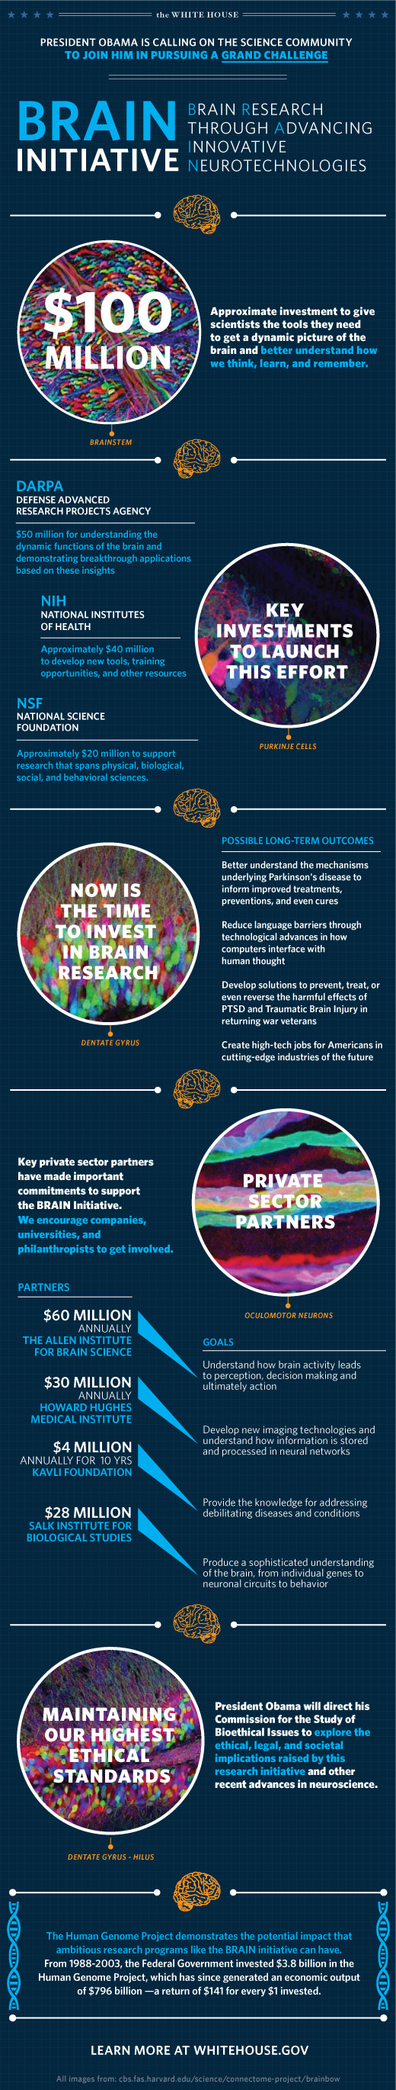

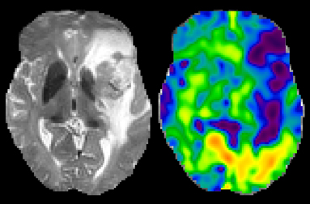
STORIES OF INSPIRATION & INNOVATION
Marty Burke—Developing new therapies through an innovative approach that reconfigures natural substances into best-in-class medicines
BRAIN Initiative—Martha Gillette, Jonathan Sweedler, and Rohit Bhargava awarded $2M from NIH to develop analytic platform that can lead to neuro insights
Stephen Boppart—Developed a hand-held OCT probe to determine whether any cancerous tissue remains, reducing the risk of recurrence or additional procedures
Curtis Johnson—Creating next generation imaging technology to map the brain and better diagnose certain conditions

Slide 8
OUR BUSINESS MODEL IS INNOVATIVE
Medical student tuition
Corporate investments
  Including $100M commitment from Carle
Private philanthropy
NOT asking the state for new general revenue
Clinical practice revenue
Technology transfer
Notes:
This is an innovative business model built to grow and be self-sustaining. It will be funded through:
Technology transfer related to those discoveries that will advance medicine and help patients. This would include licensing, commercialization and start-up companies.
Major commitment from Carle.
Funding will also come from medical student tuition, corporate investments and private philanthropy.
We will not seek new revenue from the State of Illinois to operate the college. (However, the College of Medicine is dependent on the campus as a whole and we need the State to support the institution.)

Slide 9

OUR NEXT STEPS
Continued discussion of transition planning with UI Chicago
Development of the curriculum
Recruitment of College leadership
Preparation for LCME (Liaison Committee on Medical Education) accreditation
Notes:
Curriculum: To be reviewed and approved by the faculty, the University, IBHE and ultimately the Higher Learning Commission.

Slide 10


