Slide 1
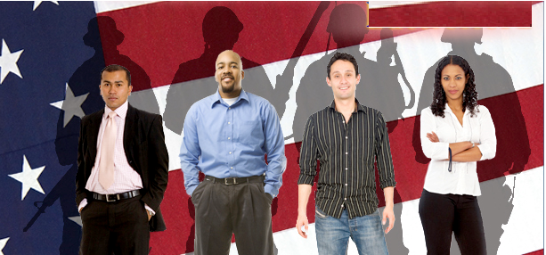
STUDENT VETERANS LEADERSHIP DAY
February 25, 2015 – Illinois State Museum
Student Veterans Leadership Day is an event for student veteran leaders attending Illinois’ colleges and universities to encourage dialogue with peers, legislators and other state leaders concerning issues impacting the student veteran community.
On-line registration will begin in January. For questions, please contact Richard Tapia at tapia@ibhe.org.

Slide 2
Student Veterans Leadership Day
Springfield, IL
Illinois State Museum
“Can you imagine what I would do if I could do all I can? “ Sun Tzu
The Student Veterans Leadership Day is meant to emphasize the role of leadership and its development in each person who has served in the military. From the day you entered the military you were introduced to a disciplined form of training, responsibility to the team, and duty to country, all become an ethos to live by.
Student Veterans Leadership Day is also designed to have you engaged, the student veteran and presenters on different aspects of leadership.
There will be four presentation panels throughout the day with respect to leadership: legislative/governmental, entrepreneurial/business, community based and educational leadership.
Panel presentations are designed to connect student veteran audience with the presenters on how leadership can be exercised. Each presentation is meant to encourage dialogue and create an interest in a particular field.
Student Veterans are an existing asset, a value to the state, their institutions, and their communities and to any enterprise they aspire to undertake after graduation.

