Slide 1
Veterans Services Provided by Illinois Community Colleges
Illinois Community College Board Meeting
January 24, 2014
Jeff Newell

Slide 2
The system is engaged in partnerships and opportunities to serve veterans.

Slide 3
A public and not-for-profit collaboration to serve veterans, service members, and their families
Bridging gaps in services to address the challenges veterans face in their communities
150+ member organizations
9 Working Groups
Notes:
http://illinoisjoiningforces.org/
ICCB participates in the Education working group. Jennifer Timmons served as co-chair of the group when she was here.
Working Groups:
Homelessness and Housing
Education
Employment & Job Training
Behavioral Health
Financial Literacy
Families, Children & Survivors
Benefits & Emergency Assistance
Legal Support
Women Veterans

Slide 4
Notes:
Illinois Joining Forces (IJF), and Student Veterans of America (SVA) have organized the Veterans as Strategic Assets Initiative which is designed to improve veteran employment in Illinois.
Illinois veterans have had a higher than average unemployment rate, though the gap has been closing. Gulf War II era Veterans in particular have a high unemployment rate (20%, 18 – 24 yr old; 10.6%, 25 – 34 yr old). This initiative marks an effort to try to improve the unemployment situation.
http://www.ides.illinois.gov/Custom/Library/Statistic/LAUS/VetsReport/VetReport_Jan14.pdf (US Bureau of Labor Statistics data)
A series of panel discussions and networking sessions have been arranged regionally across the state in February and March. Student veterans will engage with local businesses and community leaders with the goal of establishing veterans as a priority for employers. The series of events will culminate in an Hiring Our Heroes Career Fair in Chicago.
Marketing will be done for community college veteran students so they are aware of the events.
This initiative is now considered a pilot program for other states to eventually rollout.
The schedule:
Pritzker Military Museum and Library, Northwestern University, February 27 (Kickoff Event )
Western Illinois University, March 4
Southwestern Illinois College, March 18
Northern Illinois University, March 20
Strategic Assets Symposium, Chicago Union League Club, March 25
Hiring Our Heroes Career Fair, University of Illinois – Chicago, March 26

Slide 5
Military Training Counts
IJF initiative to ensure veteran and military students receive appropriate academic credit for the education, skills and experience earned in the military
Partners include:
Department of Veterans Affairs
Illinois education agencies
u.select Illinois
Illinois higher education institutions
Notes:
Veterans can struggle to complete the degrees and training they pursue even with robust support and education benefits. MTC assists veterans by giving them a strong start to their academic career.
An online course equivalency guide for military credit and course bank is being developed by u.select Illinois. This will be a start to the development of a systematic articulation tool that will allow veterans to assess where their training gets them furthest as they pursue their educational goals.

Slide 6
Military Training Counts
Automotive Service Technicians and Mechanics
Computer Support Specialists/Operators/Security Specialists
Electrical and Electronics Repairs
Military Medic
Military Police/Security
Truck Driver
Notes:
Early focus is on areas of service with densest number of servicemen involved.
Automotive Service Technicians and Mechanics (Army 91B, Marine 3521)
Computer Support Specialists/Operators/Security Specialists (Navy Information Systems Technician, Air Force 3D0X1)
Electrical and Electronics Repairs (Navy Electronics Technician)
Military Medic (Amy 68W, Navy Hospital Corpsman, Air Force 4N0X1)
Military Police/Security (Army 31B, Navy Master-At-Arms, Air Force 3P0X1, Marine 5811)
Truck Driver (Army 88M, Marine 3531)

Slide 7
Military Training Counts
Phase 1
College of DuPage
College of Lake County
Moraine Valley
Southwestern
Phase 2
Kaskaskia
Heartland
Notes:
A pilot phase has begun with community colleges working on establishing the articulation between their courses and certain certificate programs and mapping out the equivalencies in u.select. It is expected the process can take up to 5 years to complete.

Slide 8
Federal Priority - Licensure
Key:
Civilian licensing requirements
differ from military requirements
http://www.whitehouse.gov/sites/default/files/docs/military_credentialing_and_licensing_report_2-24-2013_final.pdf
Notes:
Civilian licensing requirements are seen as a key barrier to veteran employment. Military personnel are doing similar jobs, through military training/credentialing, but they don’t match civilian requirements. This creates a barrier to them transitioning into similar work in the civilian workforce.
At the federal level, several efforts are underway:
Credentialing and licensing efforts inside the military allow service members to earn civilian occupational credentials and licenses. Efforts have focused on well-paying industries and occupations that have a high demand for skilled workers, including: manufacturing; information technology; transportation and logistics; health care; and emergency medical services.
Throughout 2012, Illinois participated with the President’s Veteran Employment Task Force, Subcommittee on Credentialing & Licensing as a pilot state. Using the expertise and resources provided by this federal subcommittee, Illinois acquired military Program of Instruction documents from military schoolhouses for the Top 10 “Most Dense” military career fields. (Jennifer Timmons)
Also:
Spousal licensing legislation has been pushed 28 states have adopted legislation.
Efforts underway to get states to streamline occupational and professional licensing requirements for military personnel, allowing their training to count towards fulfillment of the requirements.
Other factors that can affect employment include (1) disabilities and (2) lack of private-sector experience (which isn’t helpful in a downturned economy).
http://www.washingtonpost.com/blogs/wonkblog/wp/2013/11/11/recent-veterans-are-still-experiencing-double-digit-unemployment/
http://www.whitehouse.gov/sites/default/files/docs/military_credentialing_and_licensing_report_2-24-2013_final.pdf
http://www.bls.gov/news.release/vet.nr0.htm
http://www.fas.org/sgp/crs/misc/R42790.pdf
http://www.bls.gov/news.release/empsit.t05.htm

Slide 9
Executive Order 13-02
Requires affected agencies to determine gaps between military education & training and professional licensure requirements
Gap assessment is to aid institutions in creating gap-bridging programs and service members in identifying outstanding requirements
Notes:
Illinois acquired military Program of Instruction documents from military schoolhouses for the Top 10 “Most Dense” military career fields. ICCB worked with the Illinois Department of Veterans’ Affairs, who spearheaded the work of state agencies overseeing LPN and EMT licenses, to assess military training against state licensing requirements (JT)
The work on the President’s Veteran Employment Task Force, Subcommittee on Credentialing & Licensing led to Executive Order 13-02.
Governor Quinn (2013) signed the order, mandating interagency cooperation and timelines to assess military training against state licensing requirements.

Slide 10
Licensure Bridges
Licensed Practical Nurse
Police Patrol Officers
Emergency Medical Technician – Basic
Notes:
Paraphrasing Jennifer Timmons:
Illinois targeted 3 areas for review: Licensed Practical Nurses (LPN), Police Patrol Officers, and Emergency Medical Technicians (“EMTs”).
In January 2013, the Board of Nursing (BON) approved a “Suggested Bridge Curriculum” for Air Force and Navy veterans who had attended training at the Medical Education and Training Campus (METC). With this suggested curriculum, the BON did the legwork for community colleges, providing a curriculum that meets pre-identified gaps in military training.
An LPN team, made up of ICCB and community college nursing directors, is looking at how to transition military medics into LPN licenses. The team has been meeting and has put together a fairly aggressive timeline to have a LPN Veteran bridge program approved. They’re working through whether it will be a new program or a reasonable and moderate extension. It is possible the program may yet come before the Board this spring, but it may not be until fall.
Work by the General Assembly and Governor Quinn allowed veterans who earned specified service medals to make application to the Illinois State Police in lieu of academic requirements.
The EMT field was opened up to veterans when the IDVA and relevant state professional regulators agreed that Army medics are qualified to become an EMT-Basic and are exempt from training, requiring only a skills check-off and passing of the written competency exam.
The Police Patrol Officer & EMT-Basic requirements were found to be “substantially equivalent” to the academic pieces so changes were made to allow those licensures.

Slide 11
Multi-State Collaborative on Military Credit
7 states involved
Key Premises:
State education agencies need to collaborate to meet the needs of service members and their families
Identify and publicize institutional best practices
Coordinate statewide efforts & adopt best practices
Federal government needs to partner with states to encourage progress
Notes:
States involved: Illinois, Indiana, Ohio, Kentucky, Michigan, Minnesota, Missouri
Work began in 2012.
Illinois is currently leading the licensing work group and sharing the process with the establishment of the Executive Order and the LPN program. (JT)

Slide 12
Multi-State Collaborative on Military Credit
Next Steps:
Address data reporting to track student success and completions
Enhance communication tools (webinars, web sites, etc.) to assist base education officers and veterans understand available options
Notes:
Members of the Collaborative are interested in beginning work on 2 new areas: data and communications. With data, states would like to develop a strategy for collecting data from institutions and states about veterans to track success and completion. There is also a real need for better communication tools – including webinars and information available on web sites – that can help base education officers and veterans understand what options are available to them. (JT)

Slide 13
Illinois community colleges provide an array of services to Illinois veterans.

Slide 14
Higher Education Veterans Service Act
Addresses needs of veterans and active duty personnel in finding education benefits and services
Requires institutions to complete survey of available services and programs
Requires a Coordinator of Veterans and Military Personnel Student Services position
Creates expectation of enhanced programs and services
Notes:
Higher Education Veterans Service Act (P.A. 96-0133) (2009)
Veterans and active duty personnel have difficulty in finding and receiving eligible state and federal education-related benefits and services
Institutions required to conduct a survey of services and programs for veterans, active duty military personnel, and their families and post to their website. ICCB coordinates the annual completion requirement.
Institutions with 1,000 full-time student headcount must have a Coordinator of Veterans and Military Personnel Student Services and create a centralized source for how to receive eligible benefits
The act also expects institutions to:
make an effort to create academic and social programs and services that provide reasonable opportunities for academic performance and success
examine how online education can be expanded or altered to serve the needs of student veterans and currently-deployed military
And report the fiscal impact of required programs and services (colleges and universities submit that information and it is reported back through IBHE’s Fiscal Impact Report)

Slide 15
Veterans Services
Notes:
Colleges have posted the surveys on their website, as has ICCB, at http://www.iccb.org/veterans_survey.html.
Many colleges have created dedicated veteran & servicemen pages on their websites in addition to the survey requirement.
Colleges have a director for veterans services on their campus or have someone who is assigned specifically to work with veterans. Veterans receive all of the same services a typical college student would, but have the added assistance of someone who is familiar with military and veterans issues, funding sources for financial aid through GI bills and the state of Illinois.
Colleges employ a number of strategies to assist veterans ranging from Veterans clubs, Veterans support groups, Veterans resource days, special ceremonies on Veterans Day, and dedicated Veterans Affairs office space so students can easily connect with services

Slide 16
Veterans Logo
Notes:
(Jennifer Timmons)
In 2009, the ICCB frequently heard from veterans that they were having difficulties finding information online because each college had their veteran information located in different places on their websites. The ICCB recognized this was a barrier for student veterans and the system created a logo (a blue box with a yellow ribbon inside stating “Supporting our Veterans”) that was presented to several groups throughout the system requesting they adopt the logo and place it on their homepage. The logo then differently links to that individual college’s veteran information. The system did adopt this universal logo and it was then presented to the National Guard for assistance in promoting to service members. Our logo has since been adopted as the universal logo for all public colleges and universities and some privates also utilize it. It is generally located on the front page of institutions’ web sites.

Slide 17
Veterans Conferences
Coordinators:
Assisting Student Veterans in Higher Education: Developing Faculty & Staff Awareness; Strategies for Addressing the Military-Civilian Gaps on Campus
April 3, 2013, Parkland College
Students:
From Combat to College: Assisting in Student Veteran Success
April 15, 2014, Illinois State University
Notes:
ICCB partnered with IDVA and IBHE in 2012 to host a Veterans Conference for Veterans Coordinators. The purpose of the conference was to build out a better network of professionals who serve veteran students with increased knowledge of support options and best practices.
ICCB has also been working with IDVA, IJF (Employment working group), IBHE, Illinois Campus Compact, and Student Veterans of America to create a conference for Student Veterans. This conference will be held on April 15, and will focus on employment preparation for veterans, building a network and having a better understanding of navigating higher education.

Slide 18
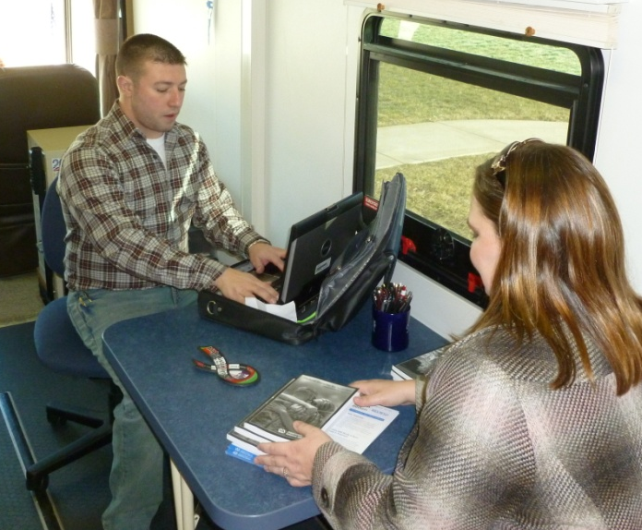
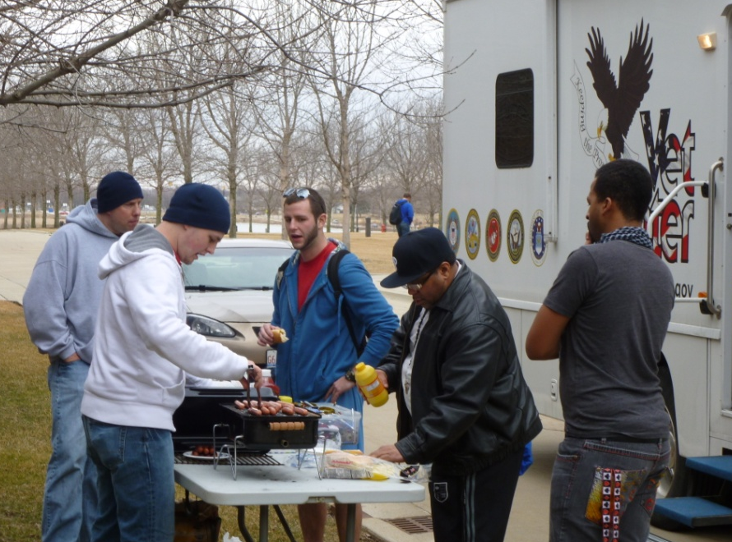
Mobile Veterans Center
Notes:
DACC (top left)
JWCC (top right)
Heartland (others)
IDVA has a Mobile Veterans Center that tours the state. It has visited all of the community colleges.

Slide 19
Veterans are coming to community colleges for education.

Slide 20
Veterans Enrolled
Notes:
Over the last five years, the number of veterans enrolled has increased. We’re now serving more veterans than ever, with over 13,000 veterans enrolled in each of the last 2 years.
IBHE is reporting in their Higher Education Veterans Service Act Fiscal Impact Reports that veteran enrollment in public universities is ranging between 5,400 and 6,400 per year. This is half or less of the enrollments we’re seeing in community colleges. Community colleges seem to be the primary destination for veterans seeking post-secondary education.
Fiscal Year - Veterans Enrolled (ICCB)
2008 – 10,892
2009 – 11,509
2010 – 12,709
2011 – 13,297
2012 – 13,225

Slide 21
Veteran Completions
Notes:
Over the last five years, the number of veterans completing community college programs has increased significantly. The vast majority are degree and certificate completions, but also includes a small number of ABE/ASE/ESL students at roughly 10 – 29 per year.
Comparatively, veterans appear to be completing programs at about 14% of enrollees vs. roughly 20% for our regular student population. There is not data available to pinpoint the reason, but it is possible that since they have 120 free credit hours of schooling available that they transition to the baccalaureate institution without an Associates as compared to the general population.

Slide 22
Degrees & Certificates
Notes:
Breaking down the degree and certificate completions, the majority of completers are in career and technical education certificate programs. There are not more than one person per year completing a certificate outside the CTE area.
The vast majority of degree completions are in the baccalaureate/transfer area. There are a small but rising number of general associates degree completions each year. GA degrees represented 7% of degree completions in 2008 (24 students) and were 12% (63 students) in 2012.
There are a small number of ABE/ASE/ESL completers each year, ranging from 10 – 29 students annually.

Slide 23
Curriculum
Liberal Arts and Sciences/Liberal Studies
Biological and Physical Sciences
General Studies
Pre-baccalaureate/Transfer Course Enrollees
Engineering Technologies and Engineering-Related Fields, Other
Health Professions and Related Clinical Sciences, Other
Criminal Justice/Police Science
Registered Nursing/Registered Nurse
Engineering, General
Engineering Technologies and Engineering-Related Fields, Other
Notes:
The top curricula cover a variety of transfer and certificate areas.
Top 10 curricula, with enrollments:
Liberal Arts and Sciences/Liberal Studies 2,636
Biological and Physical Sciences 1,766
General Studies [Curriculum designation for AGS, AGE, and ALS (general associate) 1,305
Pre-baccalaureate/Transfer Course Enrollees 905
Engineering Technologies and Engineering-Related Fields, Other 612
Health Professions and Related Clinical Sciences, Other 441
Criminal Justice/Police Science 385
Registered Nursing/Registered Nurse 292
Engineering, General 197
Engineering Technologies and Engineering-Related Fields, Other 175
11 – 20 are:
Heating/AC/ Ventilation/ Refrigeration Maintenance Tech 163
Emergency Medical Technology/Technician (EMT Paramedic) 156
Business Administration and Management, General 144
Job-Seeking/Changing Skills 142
Automotive Mechanics Tech 140
Truck & Bus Driver/ Commercial Vehicle Operation 130
Computer Systems Networking/ Telecom 129
Fire Science/ Firefighting 126
Welding Technology 125
Health Professions and Related Clinical Sciences, Other 118

Slide 24
What are the costs to the system?

Slide 25
Services Expenditures
 | FY 2013 Expenditures
 | State Funds | Other Funds | Total Funds
Coordinator of Veteran and Military Personnel Student Services | $1,729,797 | $1,808,131 | $3,537,928
Services provided to veterans but not directly related to the Act | $1,132,634 | $602,376 | $1,735,010
Total | $2,862,431 | $2,410,507 | $5,272,938
http://www.ibhe.org/Fiscal%20Affairs/PDF/2013FiscalImpactReport.pdf
Notes:
Through the Fiscal Impact Reports of the Higher Education Veterans Service Act, IBHE reports on expenditures from the public institutions in the state related to veterans services, both those required through the act and those that are not. For FY 2013, the colleges reported spending over $5 million dollars on veterans-related services. Community colleges seem to be reporting between $5M - $7M annually over the last few years.
(Side note: 9 community colleges did not report in 2013, so actual numbers will be higher. The Fiscal Impact Reports through IBHE come with some caveats. Reporting is in its first few years (began in 2010), aren’t always tracking the same things, some institutions miss reporting years. IBHE notes in their report that we can’t necessarily compare numbers across years.)

Slide 26
Illinois Veterans Grant
110 ILCS 947/40
(c) A qualified applicant is not required to pay any tuition or mandatory fees while attending a State-controlled university or public community college in this State for a period that is equivalent to 4 years of full-time enrollment, including summer terms.
Notes:
The state has long supported veterans, providing free tuition and fees for up to 4 years (120 units) at a state funded institution. The state does this through the Illinois Veterans Grant.
Must have been an Illinois resident at time of enlistment. Must have served one year or been honorably discharged for medical conditions if less than that.

Slide 27
IVG Awards
http://www.isac.org/rppa/data-book/
Notes:
The legislature provides funding for IVG reimbursements to cover the cost of tuition and fees. Colleges report costs to ISAC for IVG reimbursement. ISAC receives and disburses the funds. Over the last few years, we have seen the number of awards decrease.
Awards refer to the number of students receiving benefits.
The number of awards have been on the decline over the last few years. They had been stable for a long time, in the 7,000 – 8,000 range at community colleges, since 2004.
Public universities, in comparison, tend to have 50% – 60% of the awards that community colleges have. Community colleges are the primary place veterans are using the IVG.
The number of awards at public universities has remained more stable. Beginning with 2004, they range between 3,600 – 4,300 awards annually, with a decline occurring over the last few years.
ING awards at public universities since 2004 had been averaging 85% - 90% of community college awards, but over the last few years their awards have been trending downwards and ours are trending upwards. We had 1,856 awards in 2013 compared to 811 at pubic universities. More National Guard members seem to now be choosing community colleges for post-secondary education.

Slide 28
IVG Funding
http://www.isac.org/rppa/data-book/
Notes:
The program was well funded 10 years ago, with over $8 million in reimbursement from the state legislature. After that, funding for the program has been on the decline. 2008 & 2009 were the last years where any significant funding was provided. The funding then bottomed out. In 2011, 2013, and 2014, no funds were appropriated even though the IVG program continued.
Colleges continue to serve veteran students and report the costs to ISAC as usual and receive whatever funding is available, but it is now at best an under-funded or unfunded mandate.
We should note, too, that the colleges also provide free education through the Illinois National Guard grant. That had been well funded through 2012, but it also has not had appropriations in both 2013 and 2014. With the growth in enrollments through the ING, that is something we’ll need to monitor.
For 2013, colleges reported $10 million in free tuition and fees through the veterans grant and $2 million through the National Guard grant, resulting in a $12 million loss for the colleges.
Losses per college vary based on the veteran or military population they serve.

Slide 29
QUESTIONS

