Slide 1


Office of Education and Transition Services
Laura Gutiérrez Post-Secondary Education Specialist

Slide 2
AGENDA
Post-Secondary Education Programs
Contacting Post-Secondary Education Specialists

Slide 3
DCFS Post-Secondary EDUCATION Programs
DCFS Scholarship
Youth in College/ Vocational Training (YIC/ VT)
Tuition & Fee Waiver
Education & Training Voucher (ETV)

Slide 4
DCFS Scholarship Benefits
It is a competitive scholarship
DCFS must award a minimum of 53 each year
Monthly stipend of $1,577 for up to 5 consecutive years
One time startup funding to be used for living expenses
Illinois Medical Card
Reimbursement available for books not covered by financial aid grants
Tuition & Mandatory fee waiver if attending Illinois state funded community colleges or universities – school uses MAP and other tuition specific funds before applying the DCFS waiver.

Slide 5
DCFS Scholarship Requirements
Youth must maintain at least a “C” average each semester (2.0 term GPA)
Maintain full-time status (12 hours Fall & Spring, 6 hours or an approved internship in Summer)
Enrollment will be verified through the National Student Clearinghouse
Submit class schedule at the beginning of each semester and grades at the end of the term
Report changes to any contact information promptly to the DCFS scholarship administrator

Slide 6
2026 DCFS Scholarship application
The application period for the DCFS Scholarship is currently open
Deadline is March 31st
The official link will be available in January 2026
A complete application must be submitted to be taken into consideration
Recipients will be notified prior to May 1st

Slide 7
Youth in College/Vocational Training (YIC/VT) Benefits
DCFS must have court ordered legal responsibility for the youth; a placement for youth in care.
Monthly board payment of $1,577 for up to 5 consecutive years
Rate includes approximate monthly allocations of $68 for personal allowance, $68 for clothing, $68 for utilities, $263 for food, $54 for phone, $133 for transportation, and up to $852 for rent.
Ensure student understands board payment is to be used for room/board costs.
The program benefits end once a bachelor’s degree is earned or through age 25; whichever occurs first.
Reimbursement for books not covered by financial aid grants.
One time startup funding to be used for living expenses

Slide 8
Youth in College/Vocational Training (YIC/VT) Requirements
Youth must maintain at least a “C” average each semester (2.0 term GPA)
Maintain full-time status (12 hours Fall & Spring, 6 hours or an approved internship in Summer)
Enrollment will be verified through the National Student Clearinghouse
Submit class schedule at the state of each semester and grades at the end of the semester
Report changes to any contact information promptly to the Youth in College Coordinator

Slide 9
Education & Training Voucher (ETV)
Youth for whom DCFS is legally responsible or who aged out of care at age 18 or older OR achieved permanency at age 16 or older through either guardianship or adoption.
Up to $5,000 to cover Cost of Attendance items such as tuition, fees, books, supplies, uniforms, equipment and/or transportation not covered by other grants or scholarships.
Funding available through age 25 or 5 years if the student is continuing to make Satisfactory Academic Progress (SAP) in the program.
Award is based on Cost of Attendance and other grants/scholarships
Computers allowed ONLY if schools include a computer in their Cost of Attendance and there is funding left after tuition and fees are paid (students do not receive $5000 AND a computer).
Student may attend any school that is listed as currently accredited at
http://ope.ed.gov/accreditation/search.aspx

Slide 10
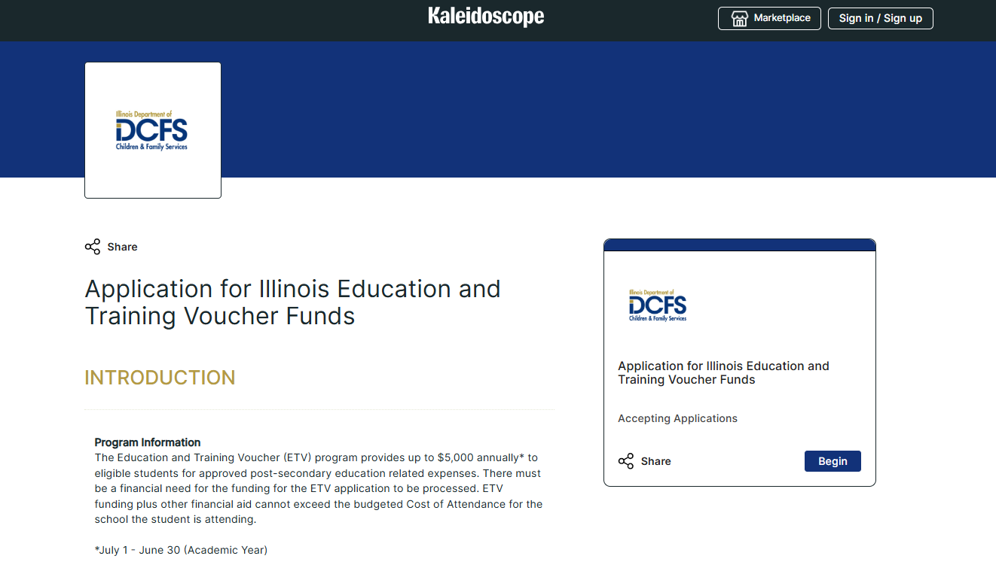
Education and Training Voucher (ETV)
A complete application must be submitted every year via
https://apply.mykaleidoscope.com/scholarships/a0DHq00000kfM8lMAE

Slide 11
Tuition & Fee Waiver
Tuition & Mandatory fee waiver if attending Illinois state funded community colleges or universities.
Department must have court ordered legal guardianship of the applicant, must have aged out of DCFS guardianship at 18 or older, or the department must have had legal guardianship prior to adoption or guardianship being finalized
Applicant must have high school diploma from an accredited institution, high school equivalency certificate, or met State criteria for high school graduation before the start of the school year for which applicant is applying for waiver
Applicant must have filed FAFSA

Slide 12
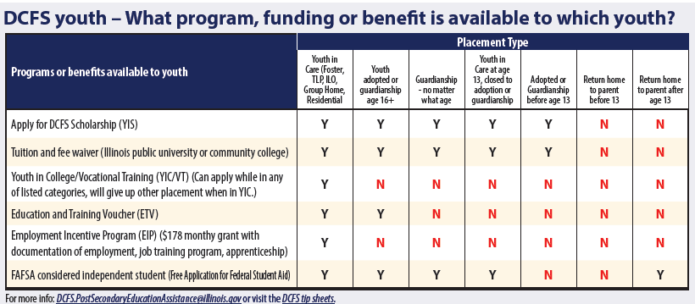

Slide 13
Contacting OETS programs
Post Secondary Education Specialists
DCFS Scholarship questions
DCFS.Scholarship@illinois.gov
DCFS Tuition and Fee Waiver
DCFS.TuitionWaiver@illinois.gov
Education and Training Voucher
DCFS.ETVCoordinator@illinois.gov
Youth in College or general questions
DCFS.PostSecondaryEducationAssistance@illinois.gov
Laura Gutiérrez
Post-Secondary Education Specialist
Laura.Gutierrez@Illinois.gov
Nashun Avery
Post-Secondary Education Specialist
Nashun.Avery@illinois.gov
DCFS.ETVCoordinator@Illinois.gov
Post-Secondary Education Services (illinois.gov)
DCFS Website > Brighter Futures > Education Resources for Youth in Care > Post-Secondary Education Services

Slide 14
THANK YOU

